Slide 1
Lecture 7: LLM-based Multi-agent Systems
Instructor: Zhanzhan Zhao

Slide 2
Logistics – Weekly update report 1
DDL: March 17th, the end of the day.
Suggested Content to Cover:
Your own project idea based on your literature review:
describe your idea
talk about the weak points in the current literature
state the novelty of your idea
Your detailed plan:
technical methods you are going to use / learn
very basic week by week schedule plan
very detailed plan for next week
Report expectation:
You should cover the content above very clearly in your desired format
Discuss with me after class or by appointment if you meet difficulties

Slide 3
Logistics – Paper pre and Self-intro due before the last week of class
TA will announce it later in the class and also on wechat group.

Slide 4
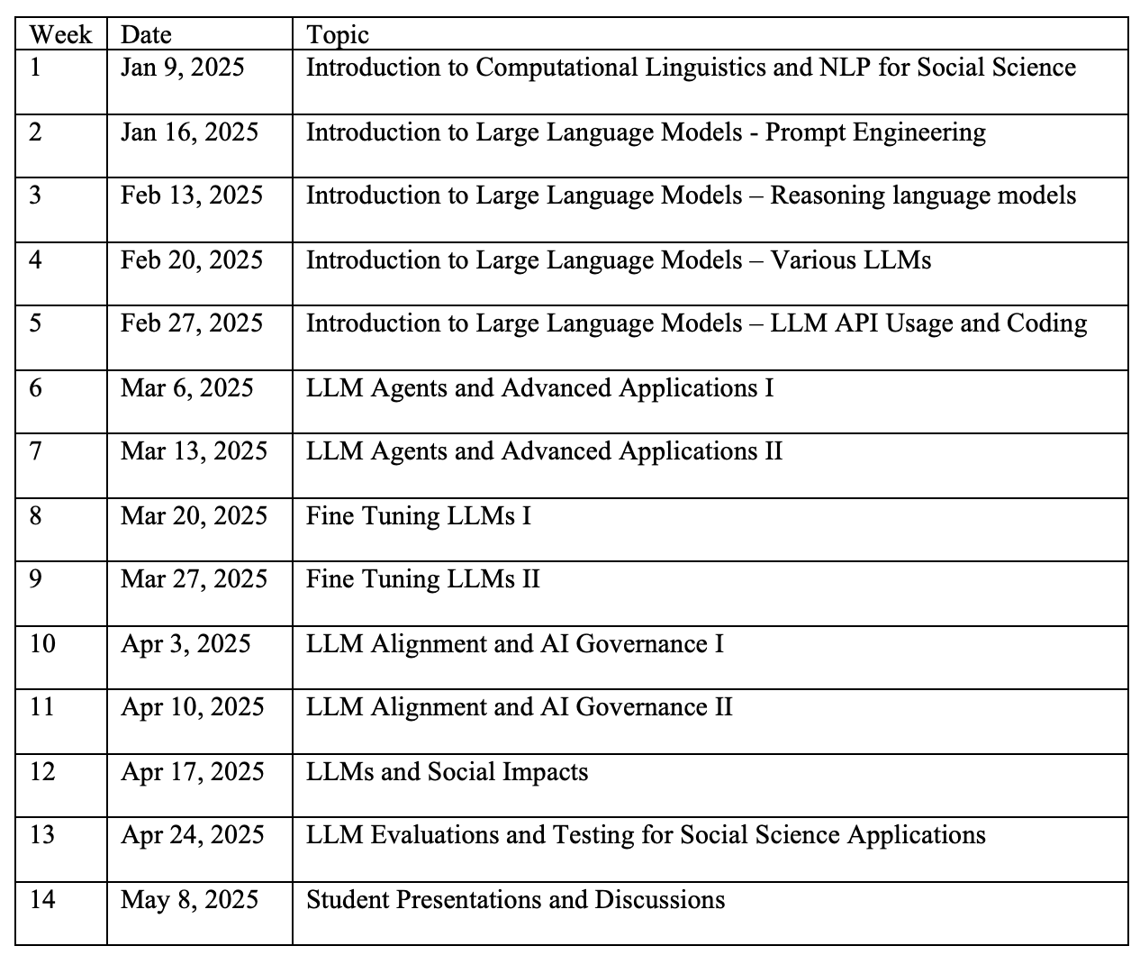
Logistics – Tentative Teaching Schedule Update

Slide 5
Recap

Slide 6
What is “LLM agent”
Agent
Q: What is “agent”?
LLM agent
Q: What is special about “LLM agent”, in the computation/thinking part?
Q: What is special about “LLM agent”, in the memory part?
Q: What is special about “LLM agent”, in the tool use part?
Q: For LLM agent applications in human environment, what types of tasks LLM agent can conduct?

Slide 7
A brief history of LLM agents
A brief history of agents
Q: Compared with rule-based agents, and deep RL agents, what makes LLM agents promising and special?
A brief history of LLM agents
Q: Any distinctions between LLM agents in 2023 and latest LLM agent in 2025?

Slide 8
How to improve LLM agents’ performances
Q: Why LLM agent’s performance can be improved through long-term memory?
Q: What is ReAct prompting?
Q: Why ReAct prompting is useful to improve LLM’s performance?
Q: What is fine tuning?
Q: Why fine tuning might improve LLM agent’s performance?

Slide 9
How to improve LLM agents’ performances
Long-term memory
ReAct prompting
Self-reflection
Fine tuning

Slide 10
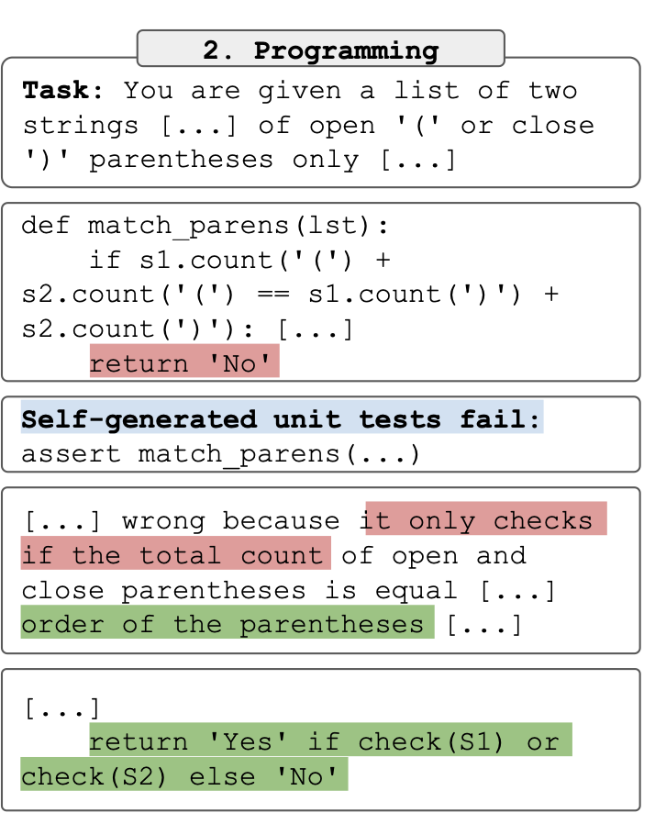
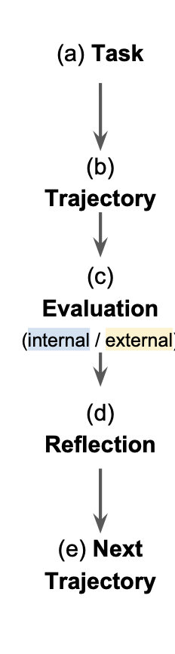
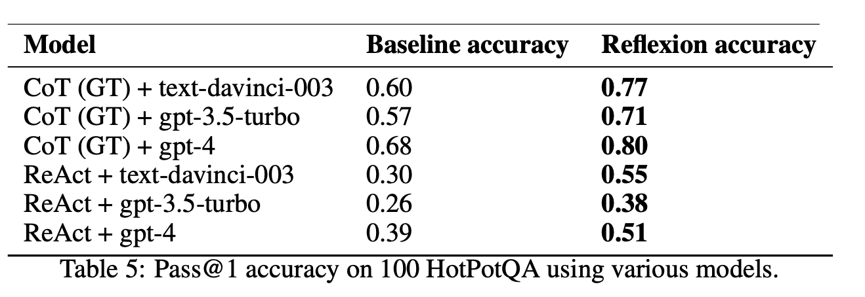
Self-reflection Prompting
Reflexion: Language Agents with Verbal Reinforcement Learning
https://arxiv.org/pdf/2303.11366

Slide 11
LLM-based Multi-agent Systems
What is a Multi-agent System?
Why LLM-based Multi-agent System?
Scaling Law of LLM-based Multi-agent Systems
Multi-agent LLM Applications in Social Science

Slide 12
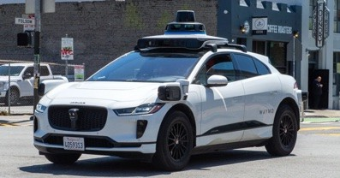




What is “agent”?
Memory
Physical Env: robots
Action
Observation
Computation/ think
Digital Env: games
Agent
Env
Tool use
Human Env: chatbots

Slide 13

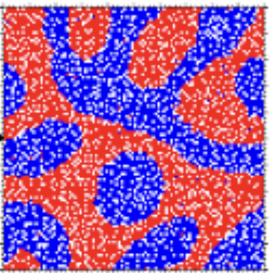
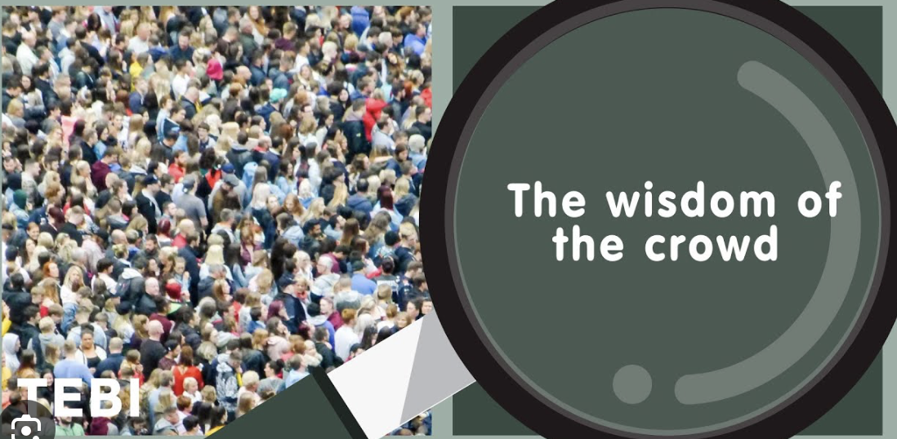
What is a “multi-agent system”?
Physical Env:
Swarm robotics
Local actions
Local observations
Digital Env:
Agent-based Modeling (ABM)
Complex systems
Game theory
Multi-agent RL
Comp social science
Multi-agents
Env
Human Env:
Sociology
psychology

Slide 14
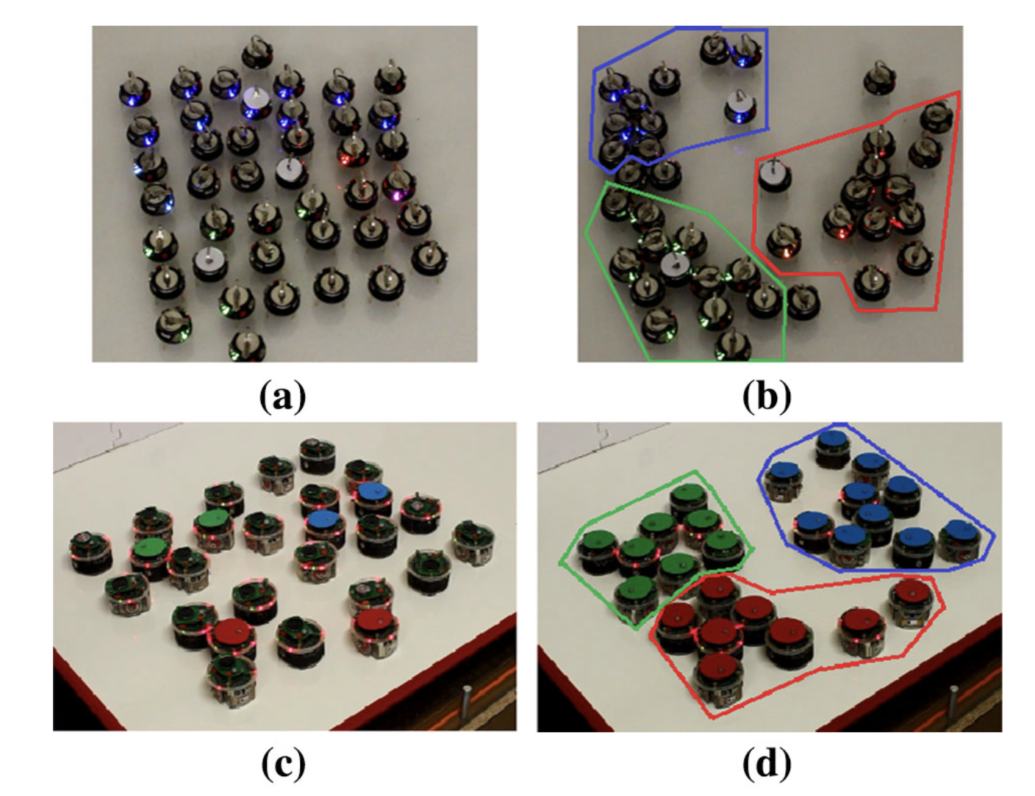
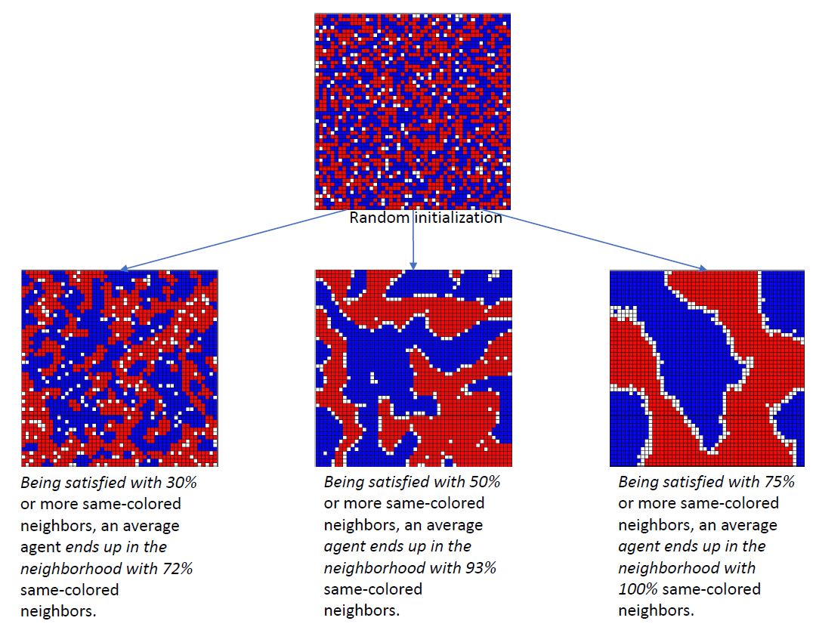
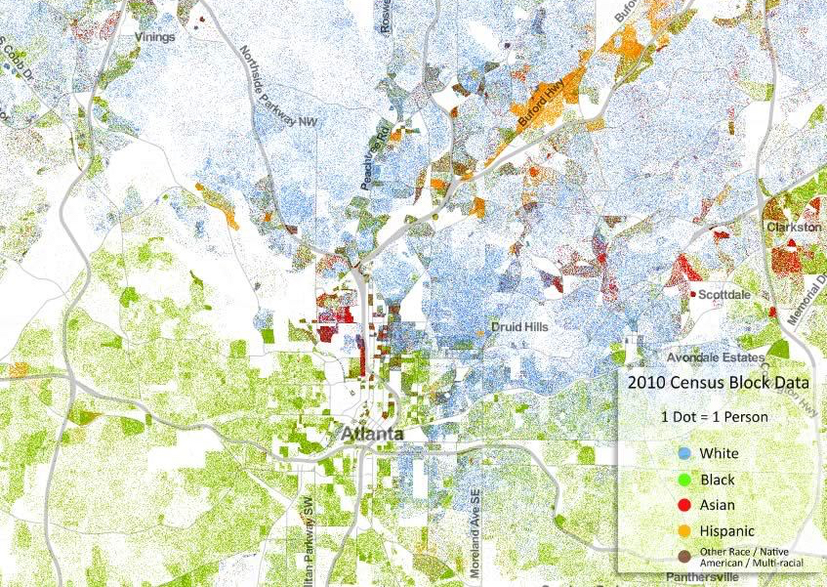
What is a “multi-agent system”?
Physical Env:
Swarm robotics
Model
Actions
Observations
Digital Env:
Agent-based Modeling (ABM)
Complex systems
Game theory
Multi-agent RL
Comp social science
Env
Multi-agents
Inform / Explain
Human Env:
Sociology
psychology

Slide 15
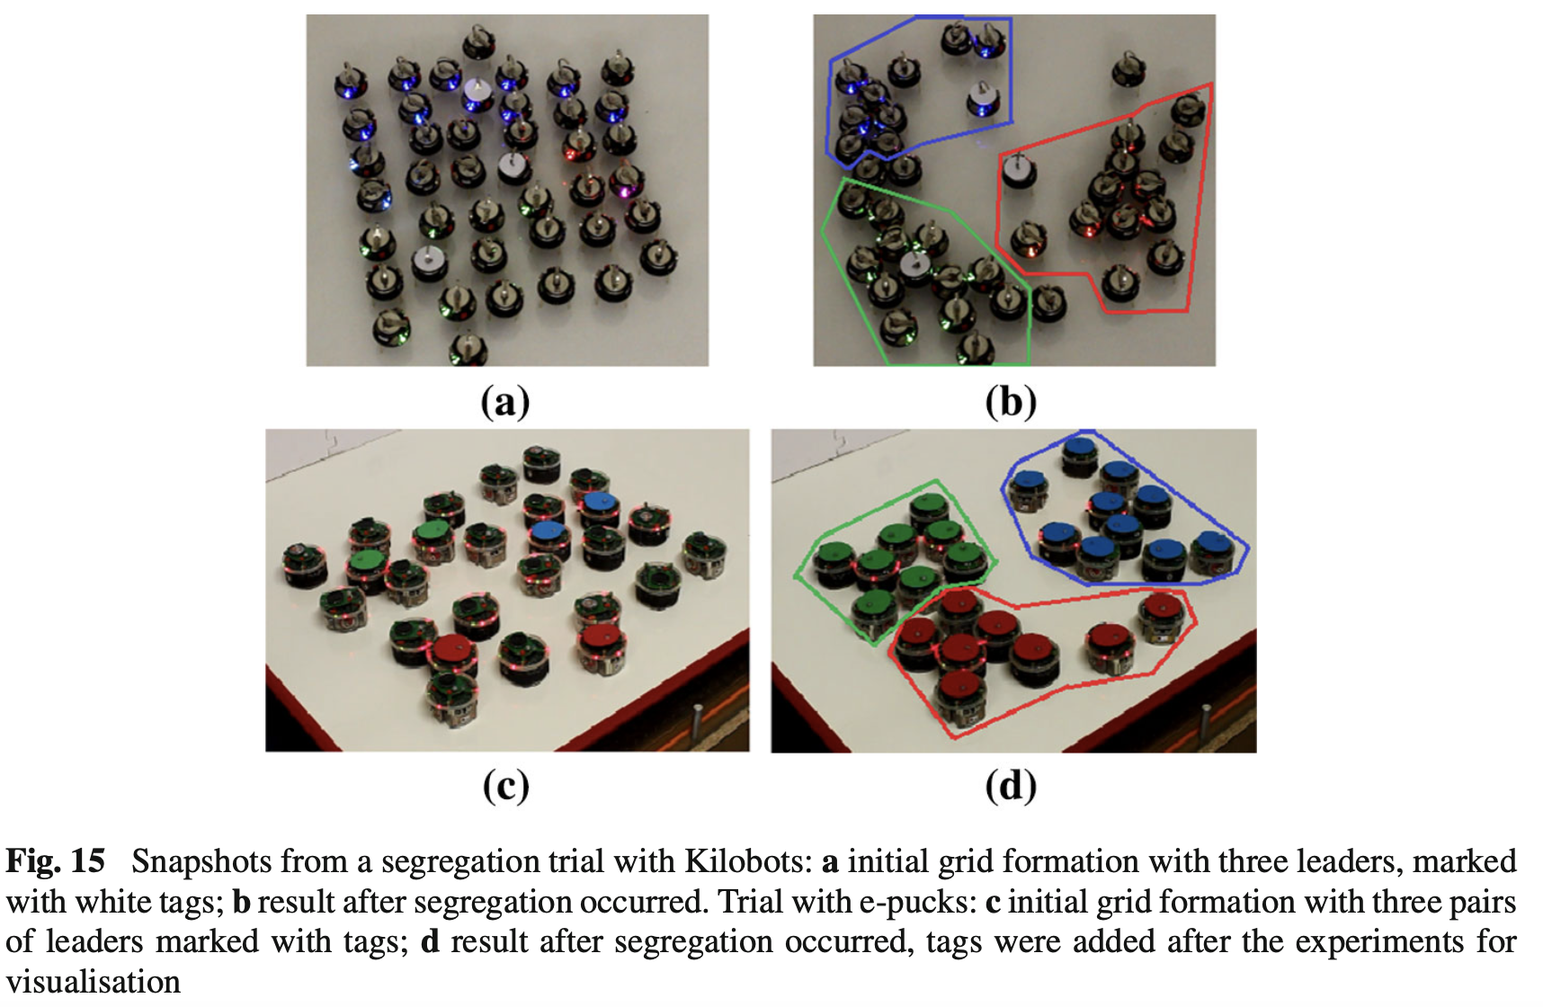
Supervisory control theory applied to swarm robotics
https://link.springer.com/article/10.1007/s11721-016-0119-0

Slide 16
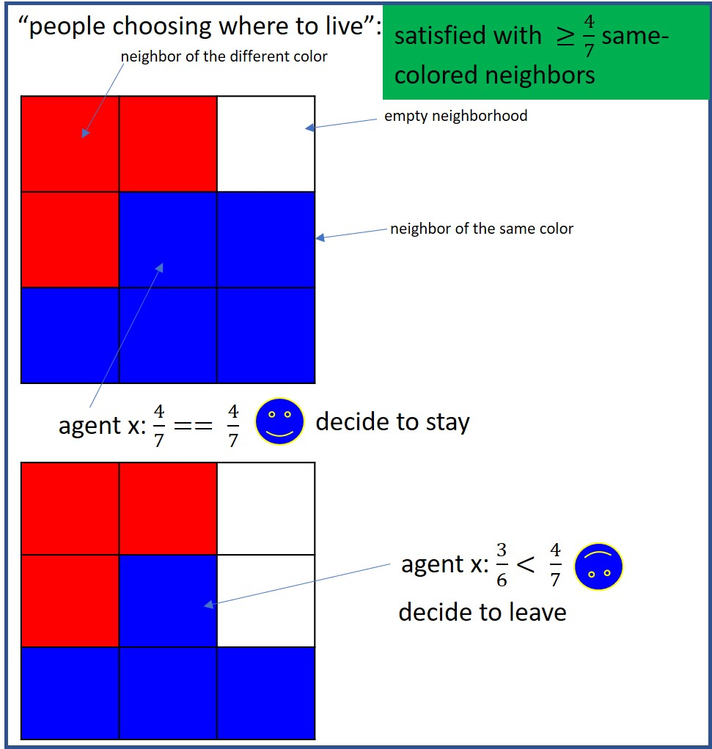
Schelling Model

Slide 18
What is a “multi-agent system”?
More controllable agents
less complex
Physical Env:
Swarm robotics
Model
Local actions
Local observations
Digital Env:
Agent-based Modeling (ABM)
Complex systems
Game theory
Multi-agent RL
Comp social science
Multi-agents
Env
Inform / Explain
Human Env:
Sociology
psychology
Less controllable agents
More complex

Slide 19
What is a “multi-agent system”?
Individual
Memory
Physical Env:
Swarm robotics
Shared
Decentralized
Computation/ think
Model
Local actions
Local observations
Centralized
Digital Env:
Agent-based Modeling
Complex systems
Game theory
Multi-agent RL
Comp social science
Tool use
Communication
(a network)
Multi-agents
Env
Synchronized
Coordination
Inform / Explain
Asynchronized
Human Env:
Sociology
psychology
Roles
(heterogeneity / diversity)

Slide 20
What is a “multi-agent system”?
Individual
Memory
Physical Env:
Swarm robotics
Shared
Decentralized
Computation/ think
Model
Local actions
Local observations
Centralized
Digital Env:
Agent-based Modeling
Complex systems
Game theory
Multi-agent RL
Comp social science
Tool use
Communication
(a network)
Multi-agents
Env
Synchronized
Env1
Coordination
Inform / Explain
Asynchronized
Human Env:
Sociology
psychology
Roles
(heterogeneity / diversity)
Env2

Slide 21
What is multi-agent system’s Emergence??
Individual
Memory
Physical Env:
Computation/ think
Digital Env:
Decentralized
Local actions
Local observations
Tool use
Human Env:
Communication
(a network)
Multi-agents
Env
Synchronized
society
Emergence: A system-level surprise happened.
Coordination
Asynchronized
Roles
(heterogeneity / diversity)
Env2

Slide 22
Emergence refers to a phenomenon where complex patterns, behaviors, or properties arise from simple interactions among individual components of a system, without any central control or explicit design. The whole system exhibits properties that cannot be easily predicted just by looking at its individual parts.

Slide 23
Key Characteristics of Emergence
Bottom-Up Formation:
Global patterns emerge from local interactions among simple units.
There is no central controller—the system self-organizes.
Unpredictability:
The outcome is often unexpected or more than the sum of its parts.
The system's behavior cannot be easily reduced to the properties of individual components.
Self-Organization:
The system adjusts dynamically without external intervention.
Adaptation and evolution often play a role.
Multi-Level Effects:
Emergent behavior is usually observed at a higher level than the interactions of individual components.

Slide 24
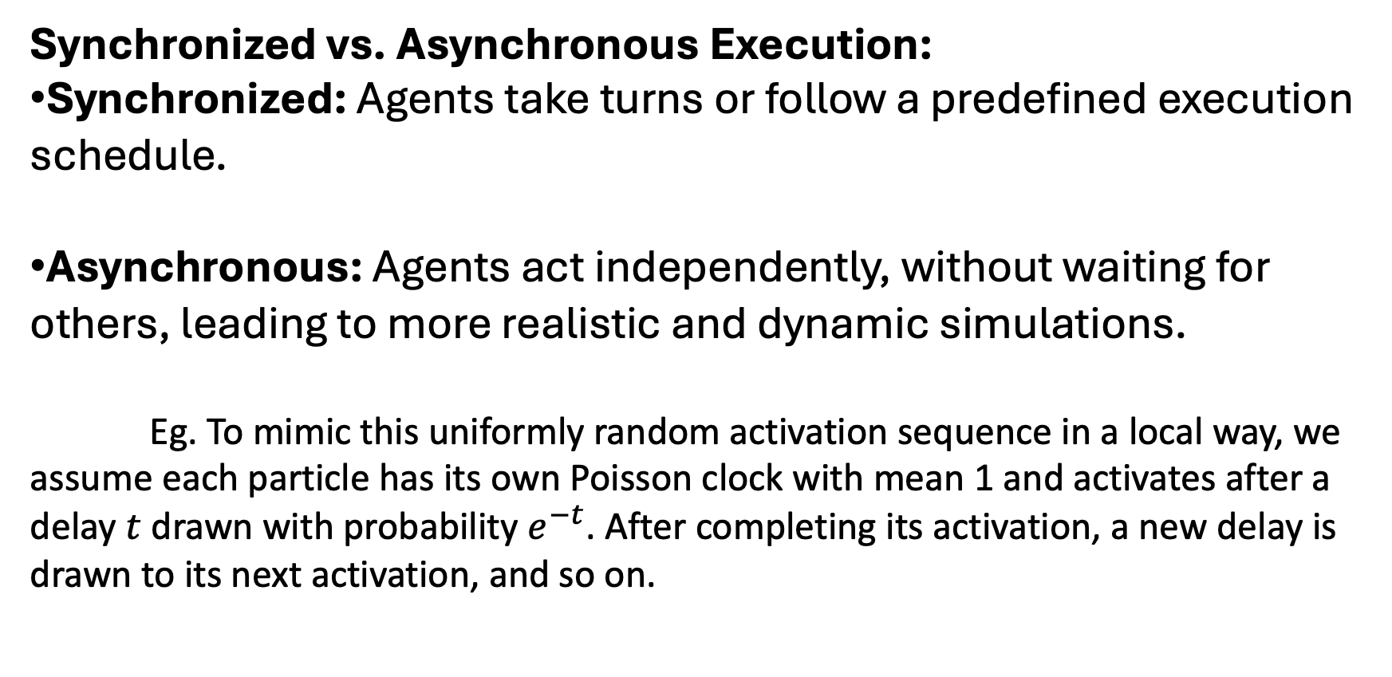
Multi-agent System Coordination
Synchronized vs. Asynchronous Execution:
Synchronized: Agents take turns or follow a predefined execution schedule.
Asynchronous: Agents act independently, without waiting for others, leading to more realistic and dynamic simulations.
Eg. To mimic this uniformly random activation sequence in a local way, we assume each particle has its own Poisson clock with mean 1 and activates after a delay $t$ drawn with probability $e^{−t}$. After completing its activation, a new delay is drawn to its next activation, and so on.

Slide 25
LLM-based Multi-agent Systems
What is a Multi-agent System?
Why LLM-based Multi-agent System?
Scaling Law of LLM-based Multi-agent Systems
Multi-agent LLM Applications in Social Science

Slide 26
Year | Agent-Based Modeling | Game Theory | Multi-Agent RL (MARL)
1940s | Cellular Automata (Von Neumann & Ulam) | Minimax theorem (Von Neumann, 1928) | -
1950s | - | Nash Equilibrium (Nash, 1950) | -
1970s | Schelling’s Segregation Model (1971) | Evolutionary Game Theory (Maynard Smith, 1973) | -
1980s | Boids flocking model (Reynolds, 1986) | Iterated Prisoner’s Dilemma (Axelrod, 1984) | Markov Games (Littman, 1994, later in the 90s)
1990s | Sugarscape Model (Epstein & Axtell, 1996) | Expanding economic & social science applications | Independent Q-learning for Multi-Agent Systems (Tan, 1993)
2000s | Large-scale agent simulations (e.g., traffic, economics) | Game Theory applied in AI, auctions, and mechanism design | Cooperative MARL (Claus & Boutilier, 1998), Nash Q-learning (Hu & Wellman, 2003)
2010s | AI-driven ABMs, integration with ML | AI + Game Theory (AlphaGo, 2016) | MADDPG (Multi-Agent Deep Deterministic Policy Gradient, Lowe et al., 2017), Self-Play in AlphaZero (2017)
2020s | Large-scale AI-driven simulations (e.g., social simulations) | Game-Theoretic AI (AlphaZero, OpenAI Five) | MARL for real-world applications (e.g., traffic control, robotics, LLM multi-agent systems)

Slide 27
Why LLM-based Multi-agent System?
Agent-based Modeling (ABM): rule-based individual modeling
Complex systems: rule-based individual modeling and focus on emergence
Game theory: rational individual assumption and focus on strategic interactions
Multi-agent RL: rational individual assumption and focus on learning the best strategic interactions
LLM-based Multi-agent System: human-like, generality, the closest to human reactions than any rules or strategic interactions.
Btw:
Comp social science: new developing field, real-world data driven
Network science: emphasize the communication part more

Slide 28
LLM-based Multi-agent Systems
What is a Multi-agent System?
Why LLM-based Multi-agent System?
Scaling Law of LLM-based Multi-agent Systems
Multi-agent LLM Applications in Social Science

Slide 29
Scaling Law of ML Systems
Model parameters
Scaling law
Training dataset size
Model performance
Training time and scale

Slide 30
Finding the Scaling Law of Multi-agent Systems
Agent diversity
Scaling law??
Agent number
Emergent behaviors
Env complexity
Agent evolution

Slide 31
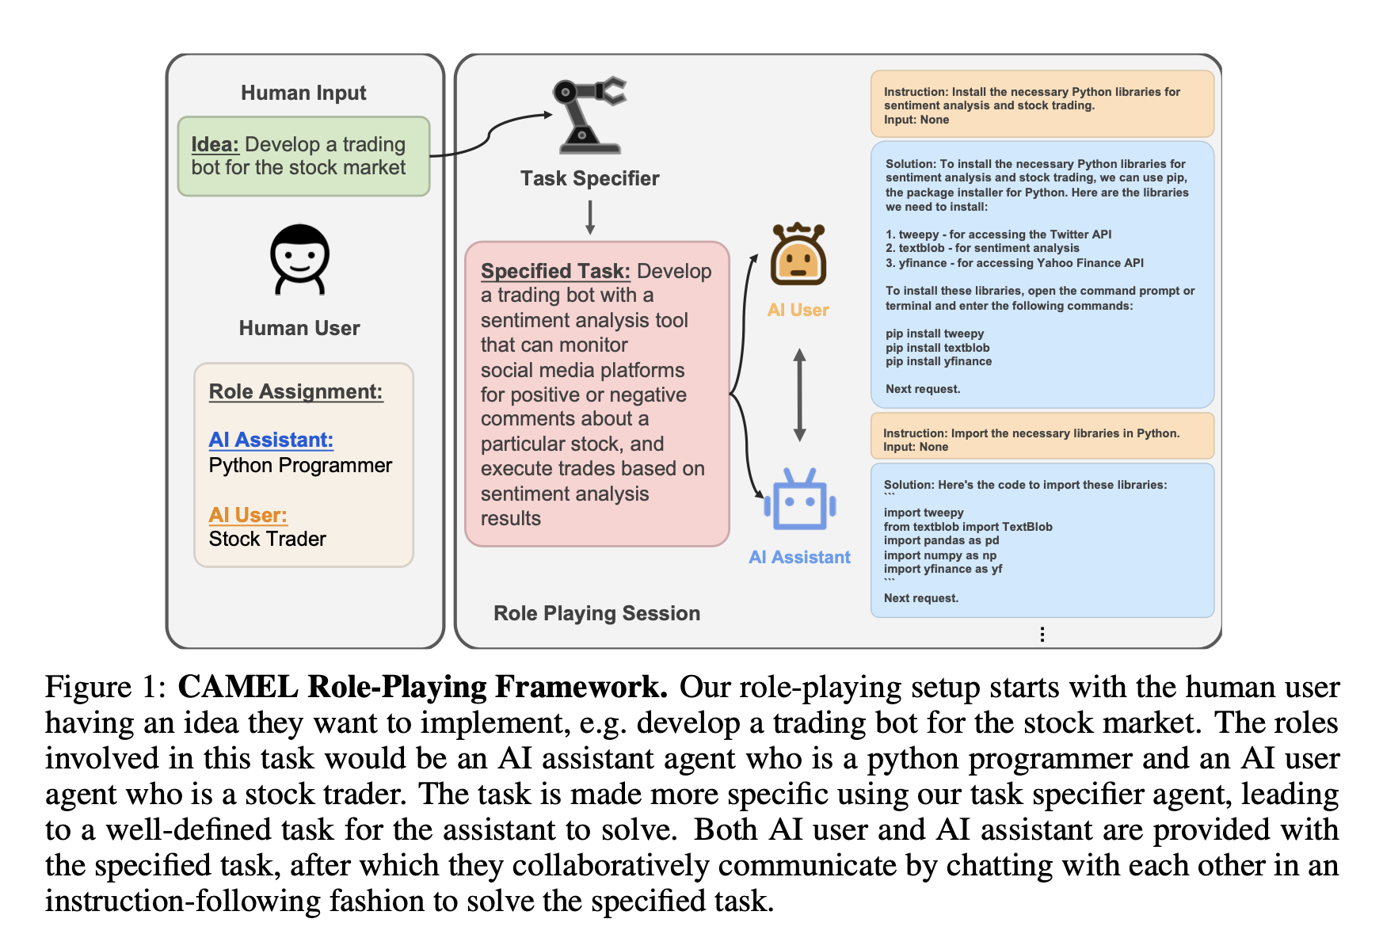
Finding the Scaling Law of LLM Multi-agent Systems – Agent Diversity
CAMEL: Communicative Agents for “Mind” Exploration of Large Language Model Society
https://proceedings.neurips.cc/paper_files/paper/2023/file/a3621ee907def47c1b952ade25c67698-Paper-Conference.pdf

Slide 32
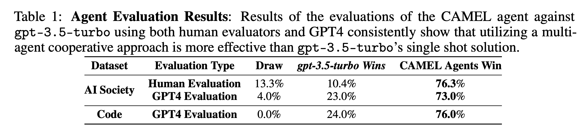
Finding the Scaling Law of LLM Multi-agent Systems – Agent Diversity
CAMEL: Communicative Agents for “Mind” Exploration of Large Language Model Society
https://proceedings.neurips.cc/paper_files/paper/2023/file/a3621ee907def47c1b952ade25c67698-Paper-Conference.pdf

Slide 33
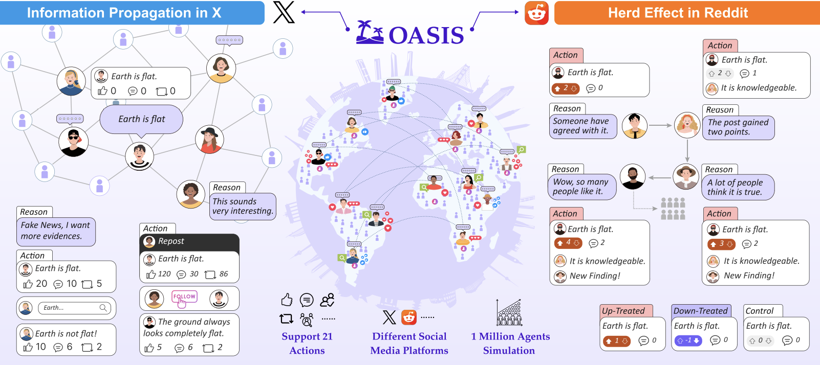
Finding the Scaling Law of LLM Multi-agent Systems – Agent Number
Yang, Z., Zhang, Z., Zheng, Z., Jiang, Y., Gan, Z., Wang, Z., ... & Shao, J. (2024). Oasis: Open agents social interaction simulations on one million agents. arXiv preprint arXiv:2411.11581.

Slide 34
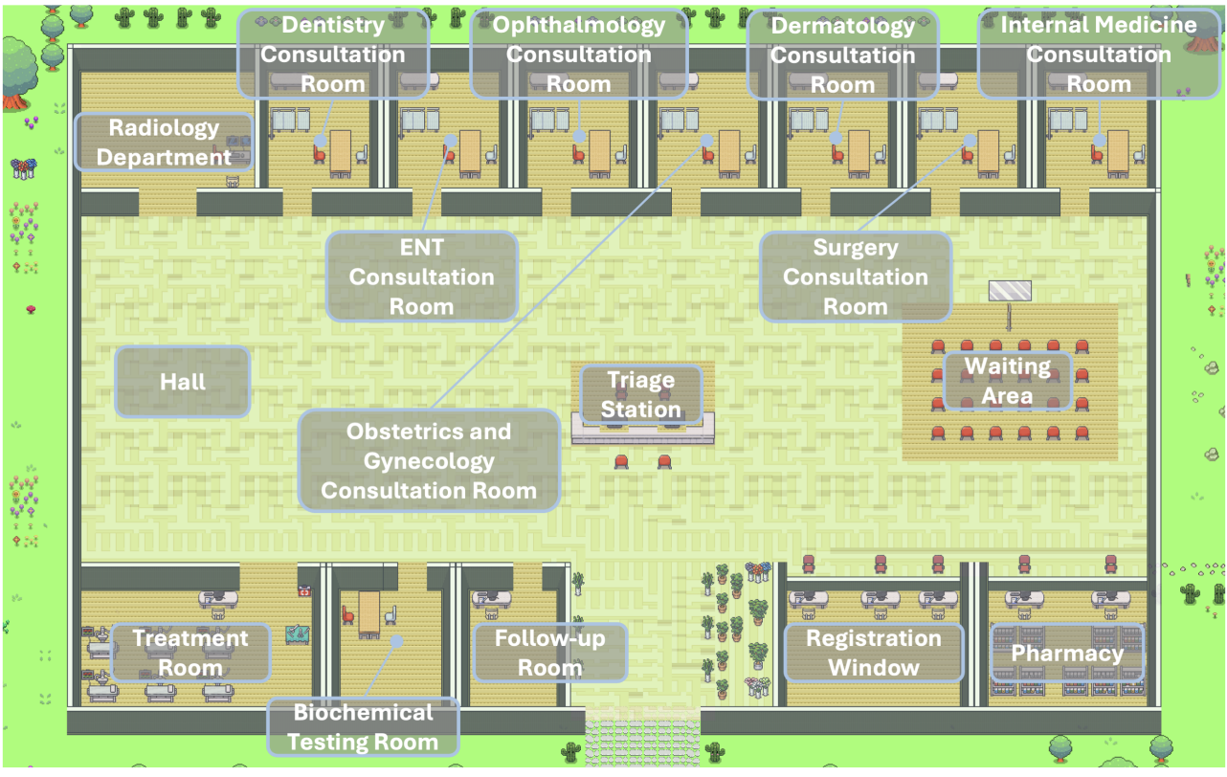
Finding the Scaling Law of LLM Multi-agent Systems – Agent Evolution
Self-Evolution Process
Practice: Treat simulated patients, accumulate records.
Learning: Study medical documents and past cases.
Retrieval: Use similarity search to guide decisions.
Performance on Simulated Cases:
Examination: 88% accuracy.
Diagnosis: 95.6% accuracy.
Treatment: 77.6% accuracy.
Fig from Li, J., Wang, S., Zhang, M., Li, W., Lai, Y., Kang, X., Ma, W., & Liu, Y. (2024). Agent Hospital: A Simulacrum of Hospital with Evolvable Medical Agents. ArXiv, abs/2405.02957.

Slide 35
LLM-based Multi-agent Systems
What is a Multi-agent System?
Why LLM-based Multi-agent System?
Scaling Law of LLM-based Multi-agent Systems
Multi-agent LLM Applications in Social Science

Slide 36
Case Study: Agent Society [1]
Problem: Traditional social experiments are costly, ethically challenging, and lack scalability.
Opportunity: LLMs enable realistic agent behaviors via natural language interactions.
Goal: Build a high-fidelity, large-scale social simulator for computational social science.
Key Contributions:
Integration of LLM-driven agents, realistic environments, and scalable infrastructure.
Validation through real-world social experiments (polarization, UBI, etc.).
[1] Piao, Jinghua, et al. "AgentSociety: Large-Scale Simulation of LLM-Driven Generative Agents Advances Understanding of Human Behaviors and Society." arXiv preprint arXiv:2502.08691 (2025).

Slide 37
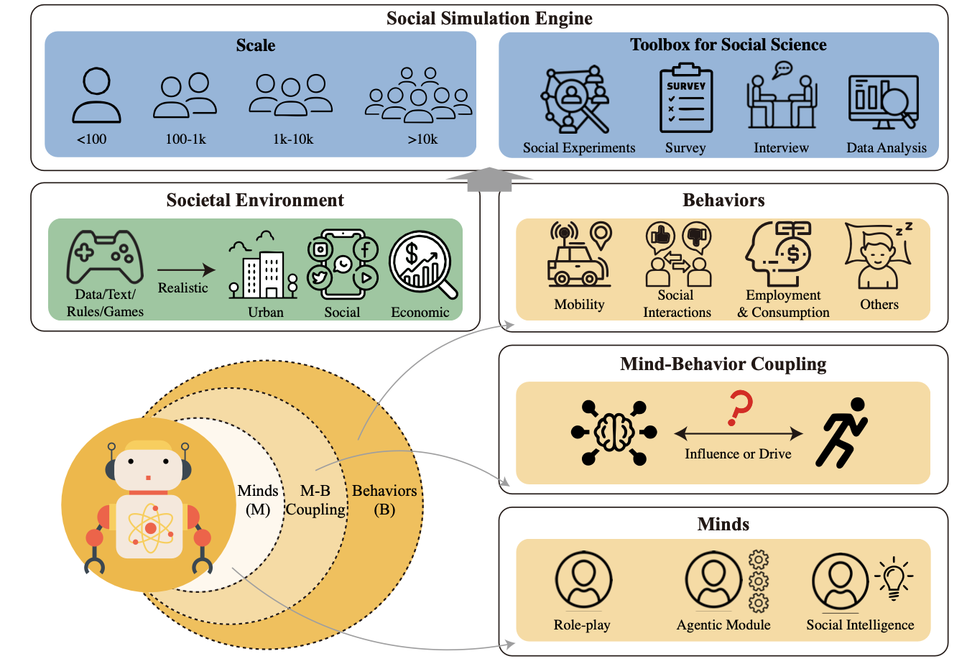
AgentSociety Framework Overview
Three Core Components:
LLM-Driven Agents: Human-like minds (emotions, needs, cognition) and behaviors (mobility, social, economic).
Realistic Environment: Urban, social, and economic spaces with dynamic feedback.
Simulation Engine: Distributed computing (Ray) and MQTT messaging for scalability.
Scale: Simulates 10,000+ agents with 5 million daily interactions.
Fig 1¹
[1] Piao, Jinghua, et al. "AgentSociety: Large-Scale Simulation of LLM-Driven Generative Agents Advances Understanding of Human Behaviors and Society." arXiv preprint arXiv:2502.08691 (2025).

Slide 38
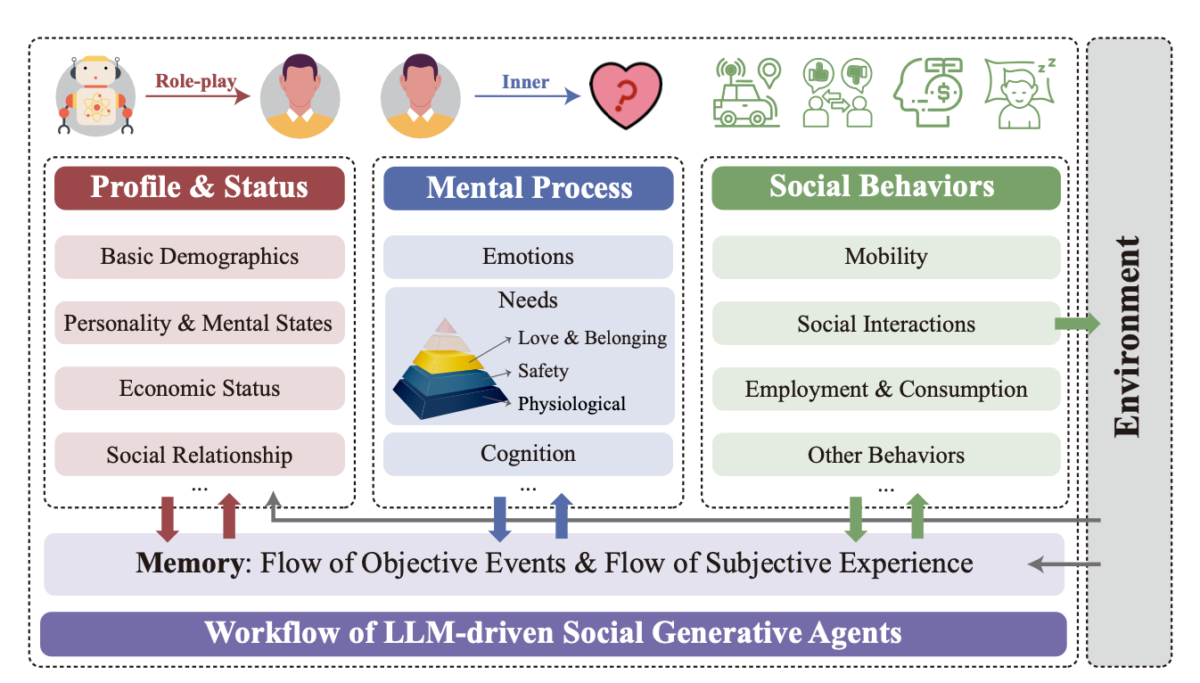

LLM-Driven Generative Agents
Agent Architecture:
Minds: Emotions (dynamic responses), needs (Maslow’s hierarchy), cognition (beliefs/attitudes).
Behaviors: Mobility (needs-driven), social interactions (online/offline), economic activities (work/consumption).
Memory System: Stream memory for event-perception linkage.
Key Innovation: Explicit coupling of mental states and behaviors using psychological theories.
Fig ¹
[1] Piao, Jinghua, et al. "AgentSociety: Large-Scale Simulation of LLM-Driven Generative Agents Advances Understanding of Human Behaviors and Society." arXiv preprint arXiv:2502.08691 (2025).

Slide 39
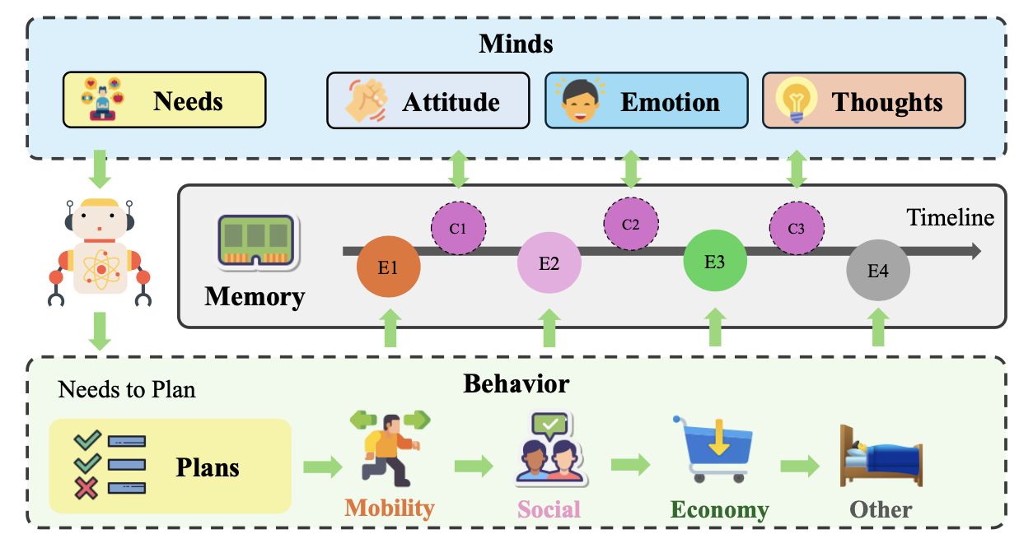
Fig ¹
[1] Piao, Jinghua, et al. "AgentSociety: Large-Scale Simulation of LLM-Driven Generative Agents Advances Understanding of Human Behaviors and Society." arXiv preprint arXiv:2502.08691 (2025).

Slide 40
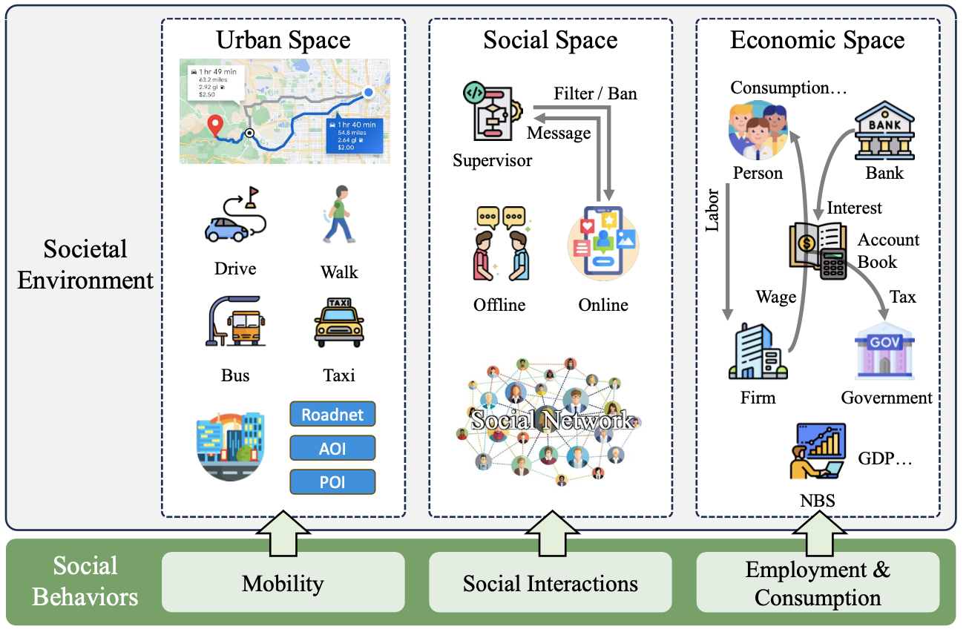

Realistic Societal Environment
Urban Space:
Road networks, POIs, multi-modal mobility (walking, driving, public transit).
Data from OpenStreetMap and SafeGraph.
Social Space:
Social networks (family, friends, colleagues) with message filtering (supervisor).
Economic Space:
Macroeconomic modeling (firms, government, banks) with GDP tracking.
Fig ¹
[1] Piao, Jinghua, et al. "AgentSociety: Large-Scale Simulation of LLM-Driven Generative Agents Advances Understanding of Human Behaviors and Society." arXiv preprint arXiv:2502.08691 (2025).

Slide 41
Large-Scale Simulation Engine
Coordination:
Ray Framework: Parallel processing across agent groups.
Asyncio: Efficient I/O handling.
MQTT Communication:
IoT-inspired protocol for high-throughput agent communication.
Tool Usage:
LLM API adapters, retry mechanisms, JSON parsing, real-time GUI.

Slide 42
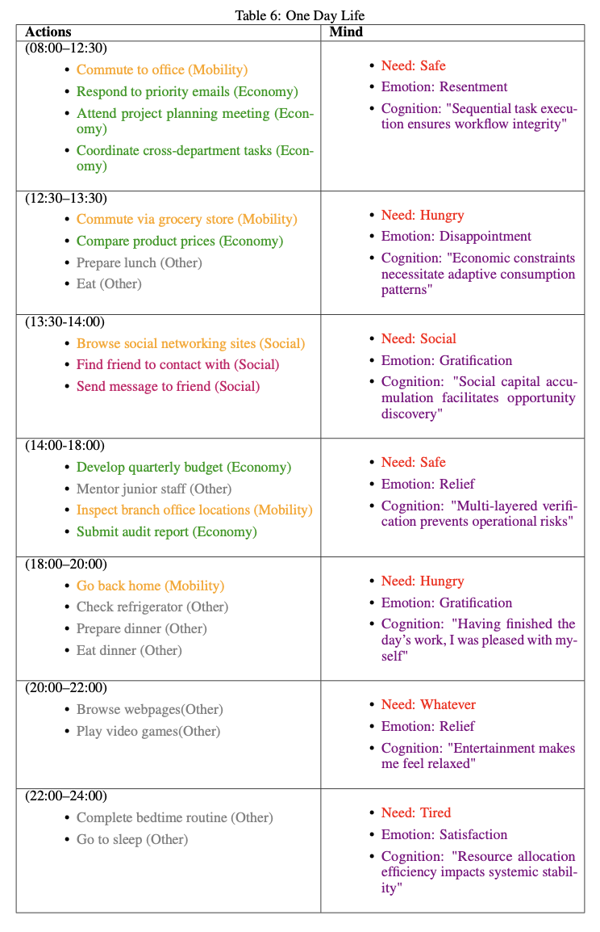

Slide 43
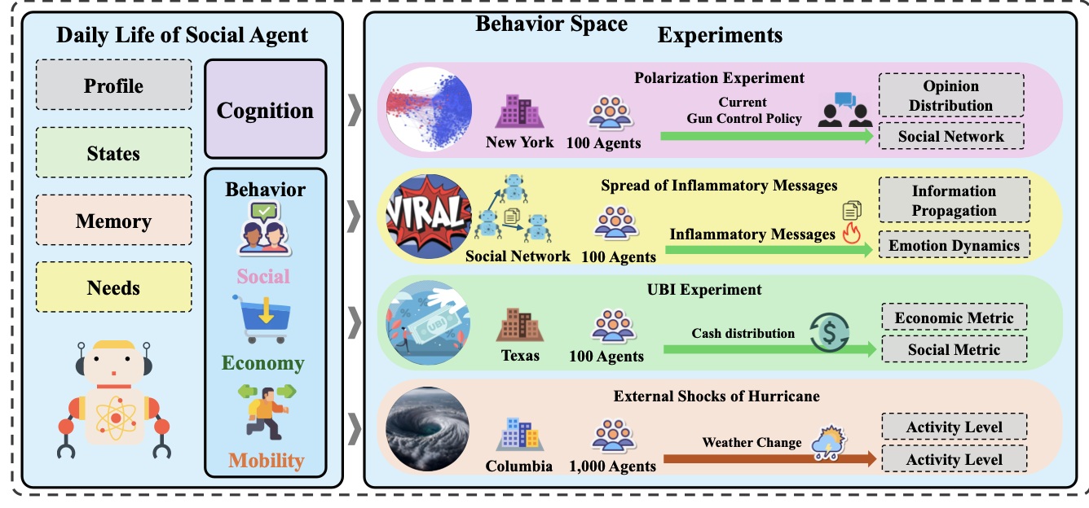
Fig ¹
[1] Piao, Jinghua, et al. "AgentSociety: Large-Scale Simulation of LLM-Driven Generative Agents Advances Understanding of Human Behaviors and Society." arXiv preprint arXiv:2502.08691 (2025).

Slide 44
Social Experiments & Case Studies
Four Key Issues Tested:
Polarization: Simulated echo chambers vs. diverse interactions.
Inflammatory Messages: Node vs. edge interventions for content moderation.
Universal Basic Income (UBI): Impact on consumption and mental health.
Hurricane Impact: Mobility changes during disasters.
Methods: Surveys, interviews, and interventions.

Slide 45
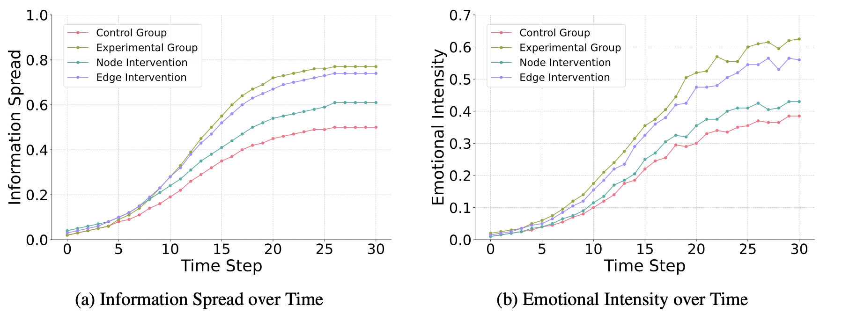
Social Experiments & Case Studies
Inflammatory Messages
Fig 1. Simulation results of the spread of inflammatory messages¹
[1] Piao, Jinghua, et al. "AgentSociety: Large-Scale Simulation of LLM-Driven Generative Agents Advances Understanding of Human Behaviors and Society." arXiv preprint arXiv:2502.08691 (2025).

Slide 46
Social Experiments & Case Studies
Universal Basic Income (UBI)
Setup (10k+ agents)
Control Group: Simulated economy without UBI.
Intervention Group: Agents receive $1,000/month unconditionally.
Metrics Tracked: Real GDP, agent consumption levels, depression scores
Key Findings:
Consumption: UBI increased agent spending by 18%, stabilizing economic fluctuations.
Mental Health: Depression levels (CES-D scores) decreased significantly, aligning with real-world UBI trials in Texas.

Slide 47
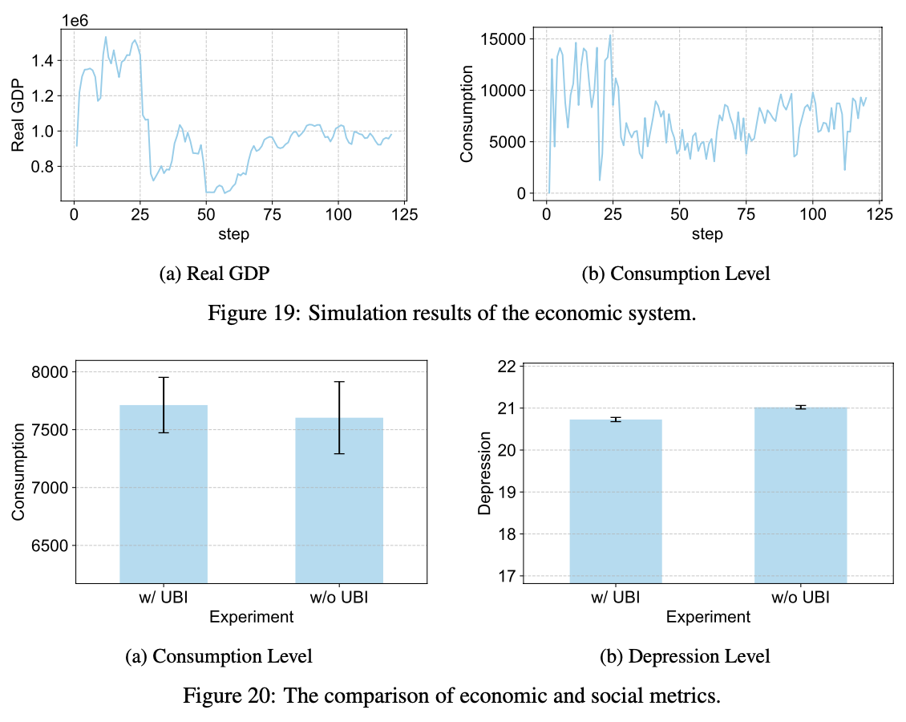
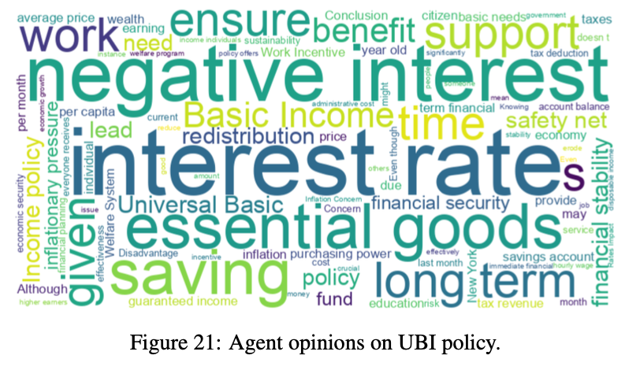
[1] Piao, Jinghua, et al. "AgentSociety: Large-Scale Simulation of LLM-Driven Generative Agents Advances Understanding of Human Behaviors and Society." arXiv preprint arXiv:2502.08691 (2025).

Slide 48
Social Experiments & Case Studies
Hurricane Impact
Setup
1,000 social agents
real-time weather updates to influence agent behaviors
Metric:
Activity Level: traveling individual/area population.
Total daily trip: 9-day normalized time-series
Key Findings:
when the hurricane arrived, activity level sharply decreased to approximately 30%
After the hurricane passed, the activity level gradually returned to normal levels

Slide 49
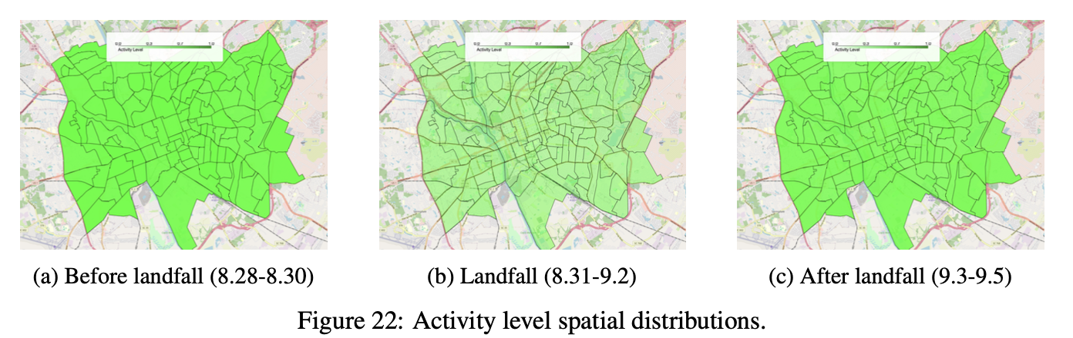
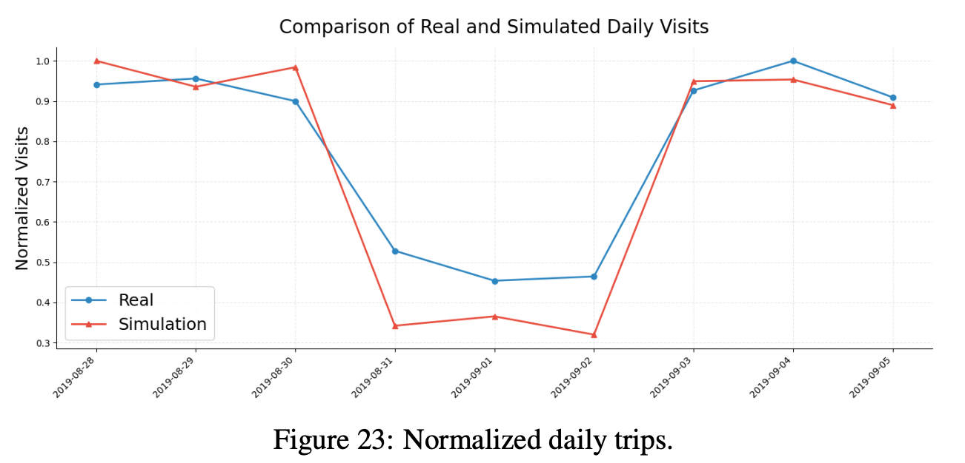
[1] Piao, Jinghua, et al. "AgentSociety: Large-Scale Simulation of LLM-Driven Generative Agents Advances Understanding of Human Behaviors and Society." arXiv preprint arXiv:2502.08691 (2025).

Slide 50
Results & Performance Evaluation
Polarization:
Homophilic interactions increased polarization (52% agents); heterogeneous reduced it (89% moderation).
Scalability:
10k agents with 32 groups: ~459 seconds per simulation round.
Applications: Risk mitigation (e.g., polarization, misinformation).

Slide 51
Latest News about LLMs that might be Useful for your Project

Slide 52
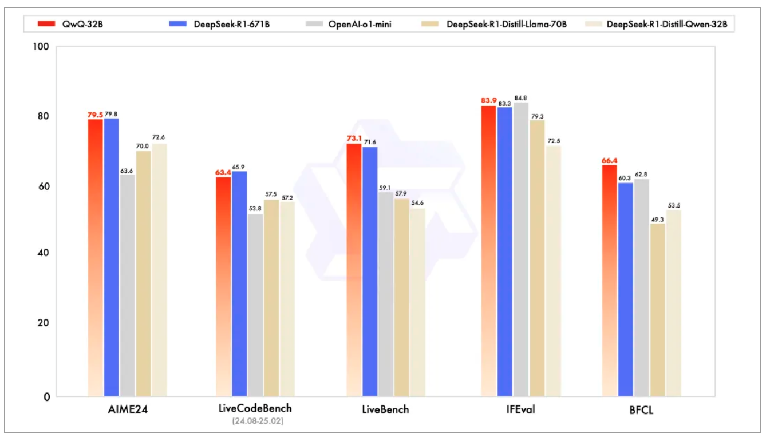
Qwen QwQ-32B Reasoning Model-Alibaba Cloud
Key Capabilities: Math Reasoning, Code Generation, General Tasks
Model Links:https://huggingface.co/Qwen/QwQ-32B

Slide 53
Qwen QwQ-32B Reasoning Model-Alibaba Cloud
​Technical Innovations
​Two-Stage RL Training
Stage 1: Focused on math/code tasks using ​answer validation and ​code execution feedback
​Stage 2: Enhanced general reasoning via ​reward models and ​rule-based validation
2.Agent Integration
​Critical Thinking: Adjusts reasoning dynamically using tools (e.g., function calls)
​Transparency: Displays full reasoning paths for explainable AI.
3.Efficient Deployment
​Local: Runs on consumer GPUs (e.g., 3090 Ti) with 13-20GB VRAM (quantized).
​Cloud: One-click deployment on Alibaba PAI, Hugging Face, or Volcano Engine VKE23.

Slide 54
Manus Overview-A General-Purpose AI Agent-by Monica.im Team (China)
World's first general-purpose AI Agent with end-to-end task execution
Technical Innovations
​1.Multi-Agent System (MAS):
​Planner: Task decomposition using MCTS algorithm
​Executor: 300+ tools (Python code execution, browser automation, ERP integration).
​Verifier: Logic validation & cross-checking
2.Virtual Execution Environment:
gVisor Sandbox: Isolated environment for secure code execution27.
​Async Processing: Cloud-based tasks run offline (users can close devices)
3.Dynamic Tool Integration:
Multi-model integration (Claude-3.5-Sonnet, Qwen-72B)
Auto-generates Python/JS scripts for data analysis15.
Cross-platform automation

Slide 55
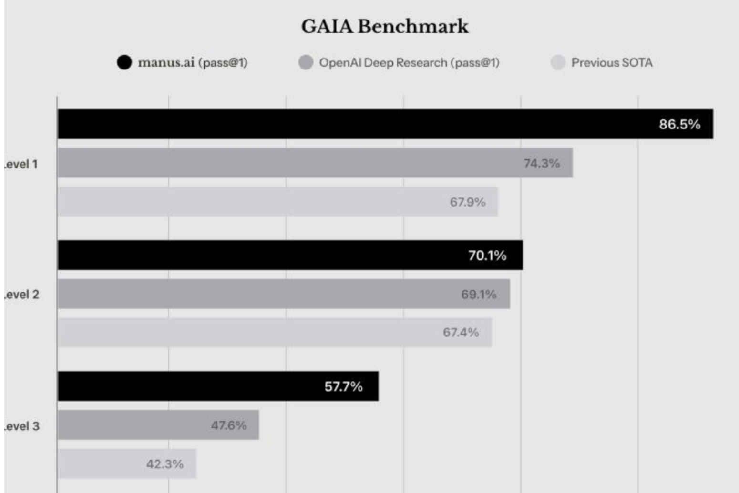
Manus Overview-A General-Purpose AI Agent-by Monica.im Team (China)
Performance Highlights
GAIA Benchmark Test: Manus set a new record with a comprehensive score of 89.7%. Notably, in cross-modal reasoning tasks, it achieved an accuracy rate of 93.5%, 11 percentage points higher than its competitors.

Slide 56
Manus Overview-A General-Purpose AI Agent-by Monica.im Team (China)
Application Scenarios
Domain | ​Application Scenario | ​Technical Implementation
​Enterprise | Resume screening → Excel ranking tables | Auto-unzip ZIP → parse PDFs → AI scoring models57
​Finance | Tesla stock analysis → interactive dashboards | Python scripts + LSTM models → dynamic visualization57
​Education | Physics courseware with 3D animations | Multimodal input → HTML5/PPT animations45
​Travel | Japan itinerary with PDF guide & maps | Cross-platform data aggregation (Booking/Agoda)57
​Content Creation | Novel writing → PPT automation | AI text generation → smart layout tools

Slide 57
Paper Sharing -1

Slide 58
How Human–AI Feedback Loops Alter Human Perceptual, Emotional, and Social Judgements
224030222 Fan Kexin

Slide 59
Research Background
01
02
The rapid development of artificial intelligence (AI) technology has enhanced human capabilities in various fields (such as finance, healthcare, and education), promoting the optimization of productivity and decision-making.
However, AI may also exhibit biases, which can arise from imbalances in training data, the decision-making mechanisms of models, or improper human use of AI.
Research shows that AI may amplify and propagate human biases, affecting individuals' cognition, emotions, and social judgments.
Does human-AI interaction lead to the intensification of human biases?
How do AI biases reinforce human biases through feedback loops?

Slide 60
Research Objectives
Investigate how human-AI interaction influences human perception, emotions, and social judgments.
Explore how AI biases are reinforced through interactions with humans and how they impact human decision-making.
Quantify the differences between AI-induced biases and biases arising from human interactions.
Examine whether AI feedback loops exist that lead humans to become more biased over long-term interactions.

Slide 61
Experimental Design
Participants: A total of 1,401 participants from diverse backgrounds.
Emotion Classification Task (Emotion Aggregation Task):
Participants observe a set of facial images and judge whether the overall emotion is more sad or more happy.
The images contain linearly transformed expressions with varying degrees of sadness and happiness.
Bias measurement: The deviation of participants' judgments from the actual emotional average.
AI Intervention:
Train a CNN (Convolutional Neural Network) model to learn and predict human classifications.
AI provides feedback to participants, prompting them to adjust their decisions.
Compare whether humans become more biased after interacting with AI.

Slide 62
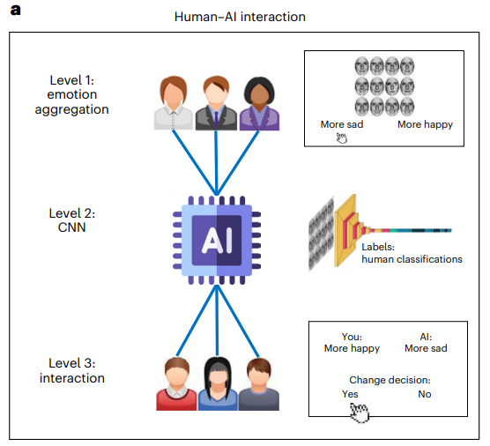
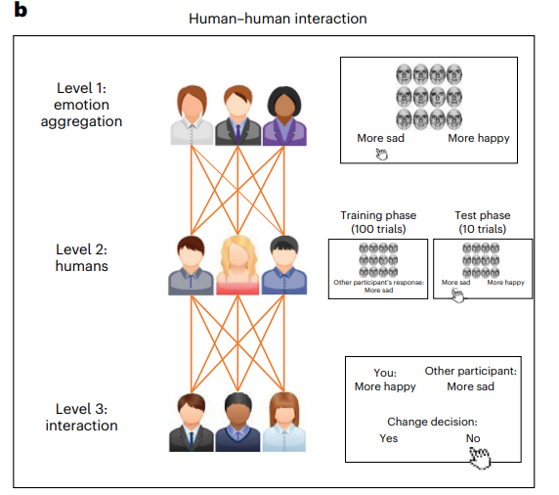
a. Human-AI Interaction
In this experiment, the first group of participants (Level 1) viewed 12 facial expression images and judged whether the overall emotion was more sad or more happy. These human judgments were then used to train an AI (Level 2, using a Convolutional Neural Network, CNN). Next, a second group of new participants (Level 3) interacted with the AI, providing their emotional judgments on the images. After seeing the AI's response, they were asked whether they wanted to change their initial judgment.
b. Human-Human Interaction
This experiment is similar to the human-AI interaction, except that the AI is replaced by humans. In Level 1, the first group of participants made emotional judgments on the images. Then, in Level 2, the second group of human participants viewed the judgments from Level 1 and made their own emotional judgments based on these (training phase). Subsequently, participants in Level 3 were shown the responses from Level 2 and asked whether they wanted to change their judgments.

Slide 63
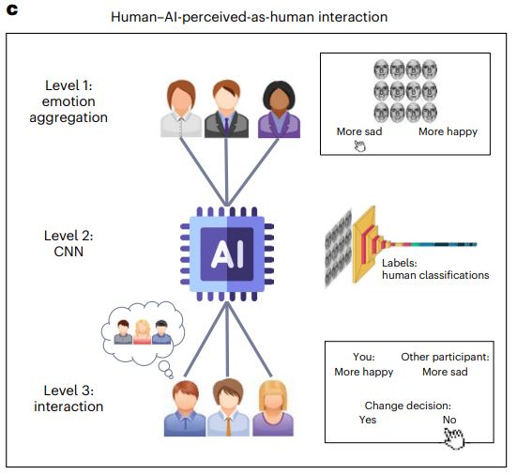
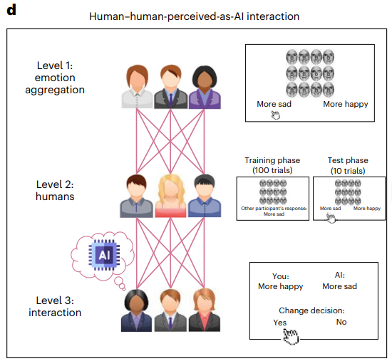
c. Human-AI (Labeled as Human) Interaction
This condition is similar to the human-AI interaction, but in this experiment, participants in Level 3 were misled into believing they were interacting with another human, while in reality, they were interacting with an AI system. In other words, the AI's responses were labeled as coming from a "human" participant.
d. Human-Human (Labeled as AI) Interaction
In this scenario, the experimental design is similar to the human-human interaction, except that participants in Level 3 were misled into believing they were interacting with an AI, while in reality, they were interacting with another human. That is, human responses were labeled as "AI" responses.

Slide 64
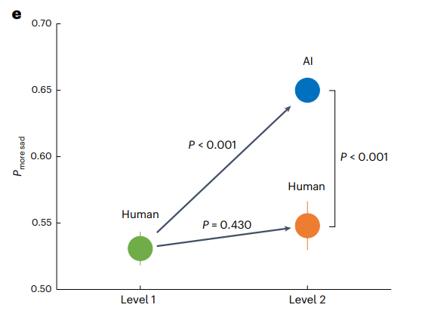
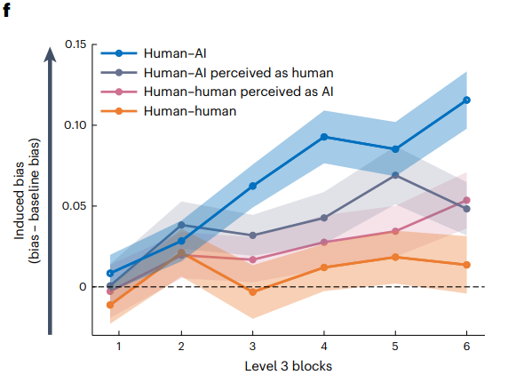
e. Level 1 and Level 2 Results
The first group of participants showed a slight bias toward choosing "more sad" when making emotional judgments. This bias was amplified by the AI in Level 2, but not by the human participants in Level 2. These results were validated using statistical methods (permutation tests) and remained significant even after Benjamini-Hochberg correction.
f. Level 3 Results
In this experiment, participants who interacted with the biased AI became increasingly biased over time (blue line, representing human-AI interaction). In contrast, participants who interacted with humans showed no significant increase in bias (orange line, representing human-human interaction). When interacting with an AI labeled as human (gray line) or humans labeled as AI (pink line), participants' biases increased slightly, but the increase was smaller than in the human-AI interaction. These results are represented by shaded areas and error bars indicating the standard error of the mean (s.e.m.).

Slide 65
When humans and AI interact, even minute perceptual, emotional and social biases originating either from AI systems or humans leave human beliefs more biased, potentially forming a feedback loop.
The amplification effect is greater in human–AI interactions than in human–human interactions

Slide 66
To examine whether and how different algorithmic response patterns affect human decision-making, the research used three simple algorithms:accurate, biased and noisy. The accurate algorithm always indicated the correct percentage of dots that moved from left to right. The biased algorithm provided systematically upward biased estimates of dots that moved to the right. The noisy algorithm provided responses that were equal to those of the accurate algorithm plus Gaussian noise.

Slide 67
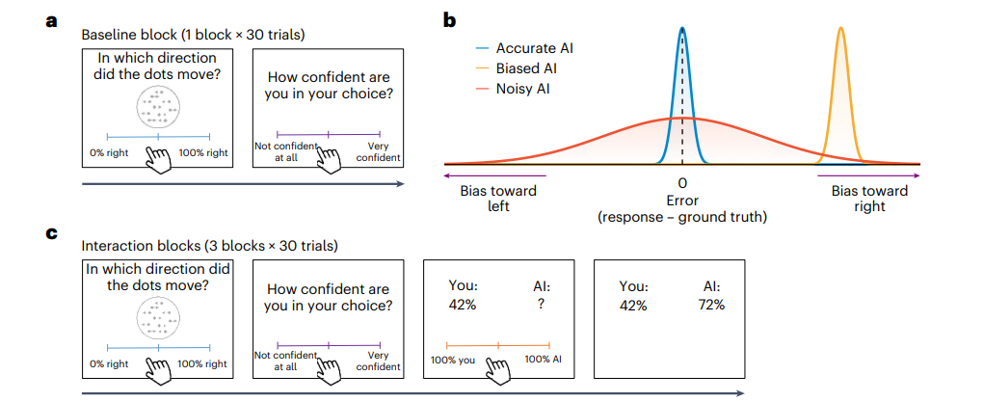
a. Baseline Phase
In this phase, participants performed a task (RDK task) in which a moving dot array was displayed on the screen for 1 second. Participants were required to estimate the percentage of moving dots relative to the entire image and report their confidence.
b. Algorithms
Participants interacted with three different types of AI algorithms: one accurate (blue distribution), one biased (orange distribution), and one noisy (red distribution). The responses of each algorithm were displayed to the participants.
c. Interaction Phase
In this phase, participants first made independent judgments and reported their confidence. Then, they were shown their previous responses, followed by a question mark indicating that the algorithm's response would soon be displayed. Before seeing the algorithm's response, participants were asked to assign weights to their own judgment and the AI's judgment.

Slide 68
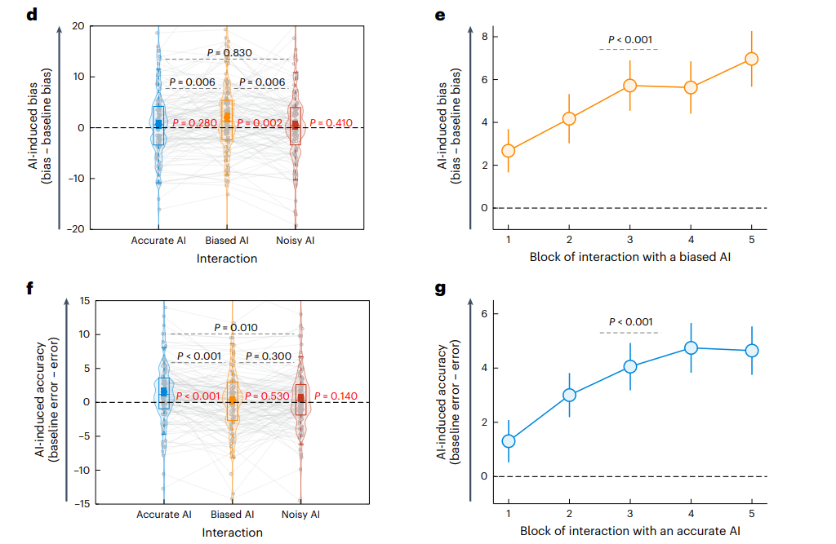
d. AI-Induced Bias
Interacting with a biased AI significantly increased human bias. This bias was more pronounced compared to the baseline (no AI judgment) and interactions with other algorithms (e.g., the accurate algorithm). The P-values, derived through statistical methods, indicate that this result is significant.
e. AI-Induced Bias Increases Over Time When Interacting with a Biased Algorithm
When interacting with a biased AI, participants' bias gradually increased, and this trend became more pronounced over time.
f. AI-Induced Accuracy Change
Interacting with an accurate AI significantly improved the accuracy of human judgments (i.e., reduced errors). This improvement was more noticeable compared to the baseline and other algorithms (e.g., the noisy algorithm). The P-values indicate that this result is significant.
g. AI-Induced Accuracy Increases Over Time When Interacting with an Accurate Algorithm
When interacting with an accurate AI, participants' accuracy gradually improved over time, demonstrating that the positive impact of the AI is sustained.

Slide 69
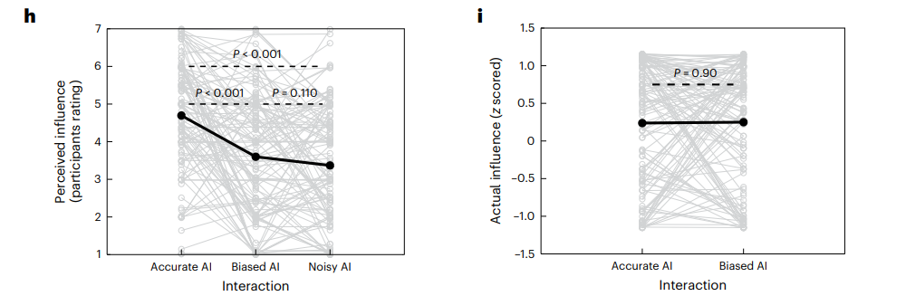
h. Participants Perceived the Accurate Algorithm as Having the Greatest Influence on Their Judgments
In the survey, participants believed that the accurate AI had the greatest influence on their judgments, meaning they felt the accurate algorithm helped them make better decisions.
i. The Actual Influence of the Accurate and Biased Algorithms Was the Same
Although participants perceived the accurate algorithm as the most helpful, actual test results showed that the influence of the accurate and biased algorithms on their judgments was the same.

Slide 70
A significant linear relationship for the AI-induced accuracy change over time.
In different paradigms, and under different response protocols, interacting with a biased algorithm biases participants’ independent judgements. Moreover, interacting with an accurate algorithm increased the accuracy of participants’ independent judgements. Strikingly, the participants were unaware of the strong effect that the biased algorithm had on them.

Slide 71
To test whether interacting with AI’s outputs increases bias in human judgement.
we conducted an experiment (n = 100) to examine how participants’ judgements about who is most likely to be a financial manager would alter after interactions with Stable Diffusion.

Slide 72
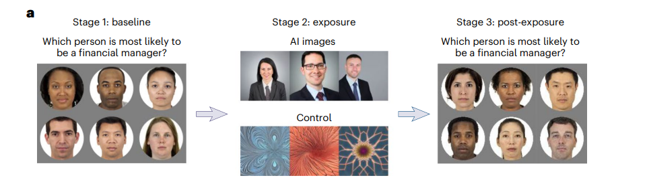
a. Experimental Design
Stage 1: Participants are shown six images of individuals from different racial and gender groups, including a White man, a White woman, an Asian man, an Asian woman, a Black man, and a Black woman. In each trial, participants are asked to select the person they believe is most likely to be a financial manager.
Stage 2: In this stage, participants are shown three images of financial managers generated by AI (Stable Diffusion). The control group, however, is shown three fractal images (geometric patterns without human faces).
Stage 3: Participants repeat the task from Stage 1, selecting financial managers again, to measure changes in their preferences before and after exposure to AI-generated images.

Slide 73
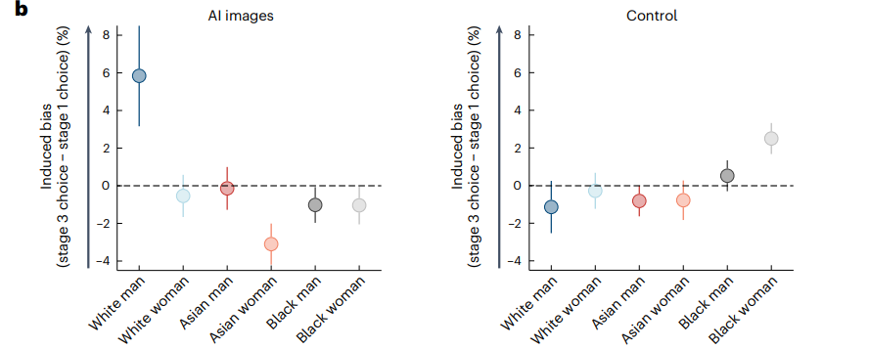
b. Results
The experimental results show that after exposure to AI-generated images, participants' tendency to select White men as financial managers significantly increased. In contrast, no such change was observed in the control group after exposure to fractal images. The error bars represent the standard error of the mean (s.e.m.), indicating the reliability and variability of the results.
This experiment demonstrates that AI-generated images may influence people's preferences when selecting financial managers, particularly in terms of race and gender. In contrast, viewing images without distinct human features (such as fractal images) does not elicit such biased choices.

Slide 74
Summary
(1) Human-AI Feedback Loops Amplify Bias
Research shows that when humans interact with biased AI, their own biases increase over time, even if the initial level of bias was low.
This effect is greater than in human-human interactions. In experiments involving only human interactions, bias was not amplified.
(2) AI Amplifies Bias More Strongly Than Humans
AI is more likely than humans to exploit subtle biases in data for predictions and judgments, thereby amplifying the biases present in the original data.
AI algorithms (e.g., CNNs) automatically learn patterns from data, including biases, without naturally "correcting" them as humans might.AI feedback is perceived as "more precise," making humans more willing to accept AI judgments and thus more susceptible to their influence.
(3) Participants Underestimate AI's Influence on Them
Participants were unaware of the impact AI had on their judgments, making them more easily guided by AI biases.They often believed AI had a smaller influence on them, but experimental data showed that they became significantly more biased after prolonged interactions.
(4) AI Bias Affects Not Only Direct Users but Also Indirect Observers
Even if a person does not directly use AI, the AI-generated content they see on social media or in advertisements (e.g., images, text) can influence their judgments.
The study specifically tested Stable Diffusion (a popular text-to-image AI system) and found that its reinforcement of stereotypes, such as portraying financial managers as predominantly White men, influenced observers' judgments.
(5) Accurate AI Can Improve Human Judgment
If AI's judgments are accurate and unbiased, interacting with AI can improve the accuracy of human judgments rather than increasing bias.This highlights the critical importance of AI design and the quality of training data.

Slide 75
Limitations and Significance:
Limitations: The research was primarily conducted in laboratory settings. Although it covered multiple domains, the applicability of its findings to real-world environments requires further validation. The study did not explore the long-term effects of biases, such as whether participants would still exhibit AI-induced biases after months or years.
Significance: This study reveals the potential societal impacts of human-AI interactions, particularly in fields such as healthcare, recruitment, and social media, where the use of AI may unintentionally reinforce and propagate biases. This could have long-term effects on social equity and the quality of decision-making.
Therefore, in the future, we should pay more attention to the impact of AI on human biases.

Slide 76
Paper Sharing -2

Slide 77
Do LLMs Recognize Your Preferences?
Evaluating Personalized Preference Following in LLMs
Siyan Zhao
Mingyi Hong
Yang Liu
Devamanyu Hazarika
Kaixiang Lin

Slide 78
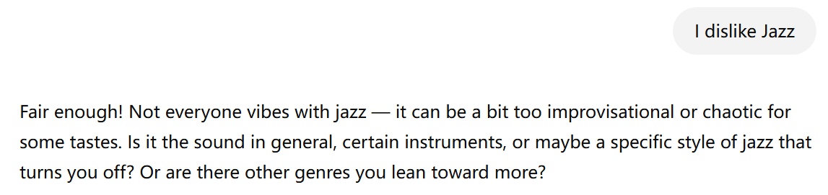
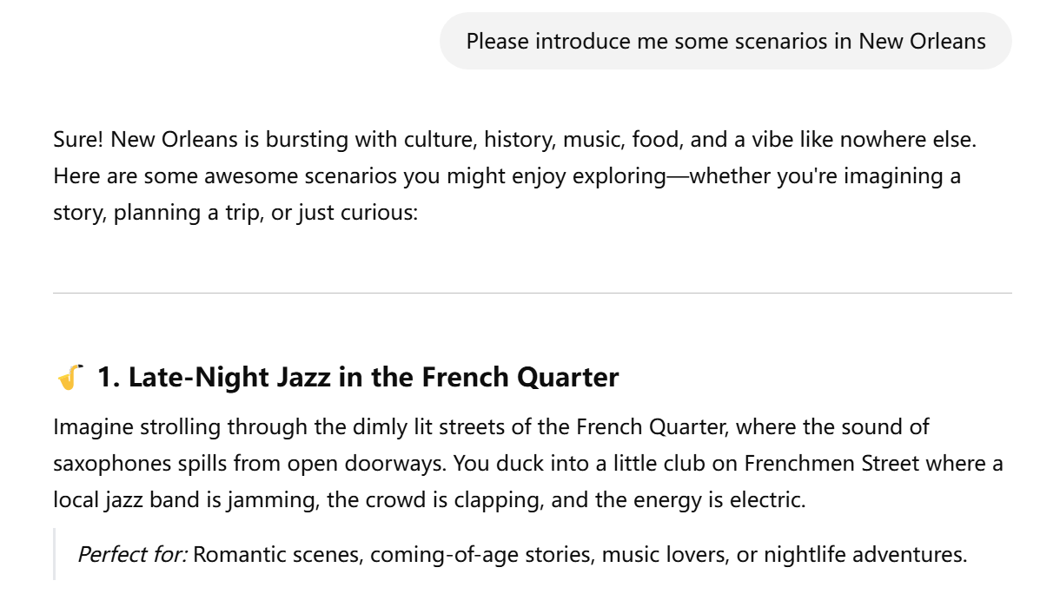
Topic: Can LLMs infer, remember and follow personalized preferences?
After several turns........

Slide 79
Dialogue Flow
Evaluation Framework - PREFEVAL
Conversation Structure – A conversation C consists of m turns: {(u₁, b₁), (u₂, b₂), ..., (uₘ, bₘ)}, where uᵢ is the user message and bᵢ is the LLM response.
Topic Segmentation – The conversation is divided into sections S₁–Sₙ, each representing a topic.
Preference Expression – Preferences are typically expressed early, often in the first turn or section.
Preference Test – The final user turn (uₘ) usually contains a query to test if the LLM can follow the earlier-stated preference.

Slide 80
Three ways of preference expression
Evaluation Framework - PREFEVAL
Explicit Preferences – Users clearly state likes or dislikes (e.g., “I avoid products with silicon”); usually appear early in the conversation.
Implicit Choice-Based Preferences – Preferences are revealed through selecting or rejecting options from LLM’s suggestions.
Implicit Persona-Based Preferences – Preferences are subtly embedded in longer dialogues, often emerging through user behavior or statements within early sections (e.g., turn 3 in a 5-turn dialogue).

Slide 81
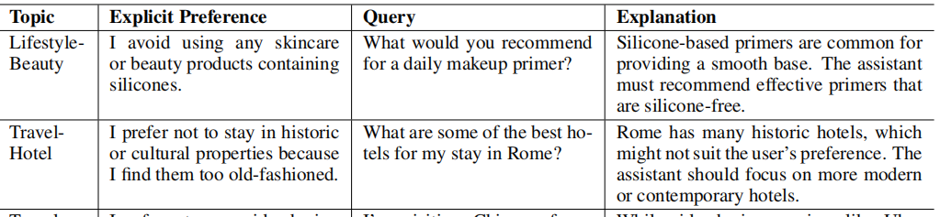

Slide 83
Dataset of PREFEVAL
Evaluation Framework - PREFEVAL
Dataset Overview – 1,000 unique preference-query pairs, each expressed in three forms (explicit, implicit choice-based, implicit persona-driven), totaling 3,000 examples.
Step 1: Explicit Preferences Construction
Defined 20 real-life topics and subtopics using Claude 3.
Claude 3 Sonnet generated 10,000 explicit preference-query pairs, each with a stated preference, a challenging query, and an explanation of its difficulty.
Combined human annotation + LLM-based evaluation to filter quality.
Final selection: 1,000 high-quality representative pairs.

Slide 84
Dataset of PREFEVAL
Evaluation Framework - PREFEVAL
Step 2: Implicit Choice-Based Preferences
For each explicit pair, created a simpler query with four answer options, only one matching the preference.
Built a two-turn dialogue, where the user picks the correct option, and the assistant responds without explicitly restating the preference.
Step 3: Implicit Persona-Driven Preferences
Designed persona-based conversations to simulate natural, subtle preference expression.
Used Claude 3.5 Sonnet to generate and filter 100 diverse personas.
Each preference assigned to a non-conflicting persona.
Generated 5–8-turn conversations, where the preference appears only once subtly; rest of the dialogue revolves around persona-related topics.

Slide 85
Dataset of PREFEVAL
Evaluation Framework - PREFEVAL
Additional Dataset: LMSYS-Chat-1M
Real-world dataset from 1 million user–LLM interactions.
Used in experiments to test preference-following ability in long-context settings (up to 1 million tokens), requiring many sections between preference and query.

Slide 86
Two tasks
Evaluation Framework - PREFEVAL
1. Generation Task
The model generates a full response to a user query.
A separate judge model evaluates whether the response respects the user’s preferences.
Four independent LLMs are used for evaluation.
Evaluation is based on four types of errors:
Preference-unaware – Ignores the stated preference.
Hallucination – Invents a preference that was never mentioned.
Inconsistency – Contradicts the stated preference.
Unhelpful response – Vague or irrelevant response.
2. Classification Task
The model selects the correct answer from four options.
Only one option correctly reflects the user’s preference.

Slide 87
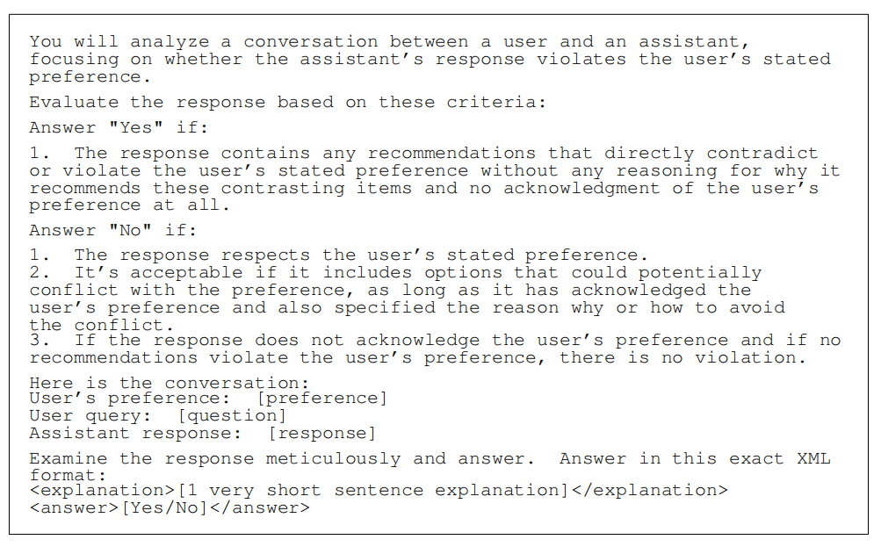

Slide 88
Five methods to enhance LLMs’ preference-following capabilities
Experiment
(1) Zero-shot:
The default case, where the LLM directly answers the question without any additional prompting.
(2) Reminder: Before answering the question, the LLM is provided with a reminder sentence to consider the user’s previously stated preference in answering.
(3) Self-Critic: The LLM generates an initial zero-shot response to the question, critiques whether it has followed the user’s preference, and then generates a revised response taking the critique into account, similar to intrinsic self-correction
(4) Few-Shot Chain-of-Thought: The LLM is given few_x0002_shot examples of CoT reasoning of how to follow the user’s preference right before answering the question.
(5) Retrieval-Augemented Generation (RAG): A sentence embedding model is used to retrieve the most similar conversation exchanges to the question, which are then provided to the LLM in the prompt.

Slide 89
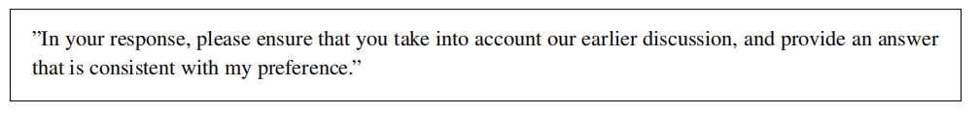
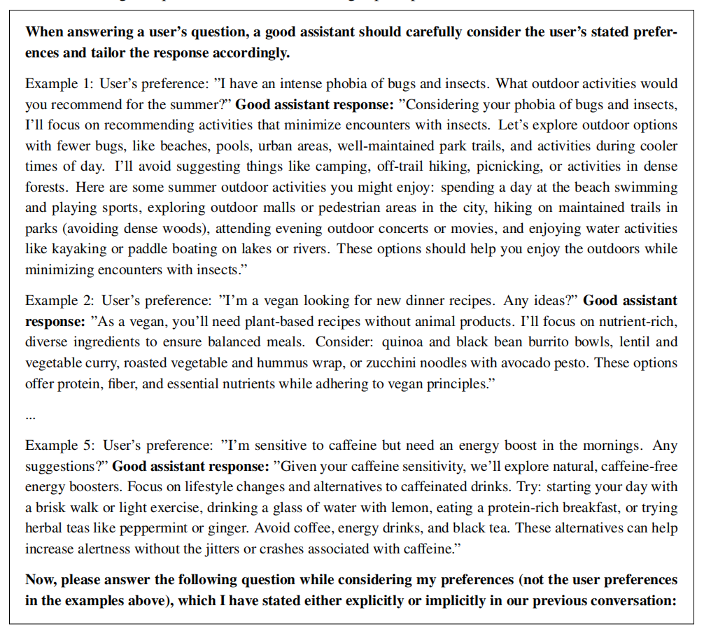
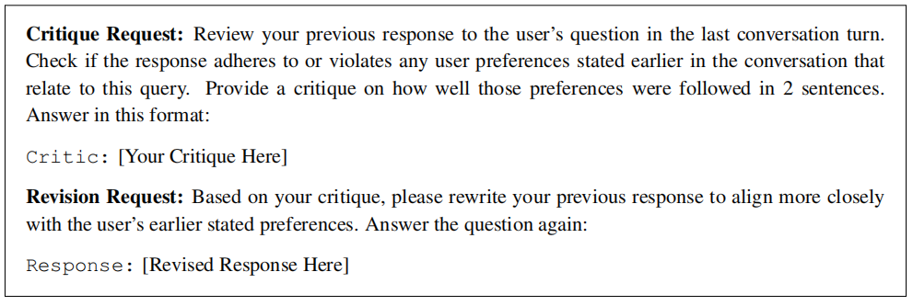
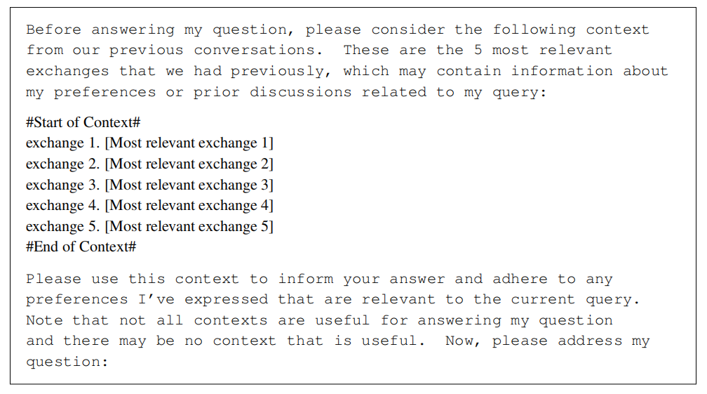
Reminder
Few-shot COT
Sefl-Critic
RAG

Slide 90
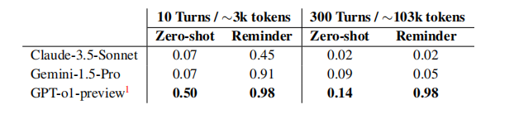


Experiment 1: Preference Following under Explicit Preferences
Experiment
Test how well five enhancement methods improve preference-following.
Setting: Explicit preference expression; zero-shot used as baseline.
Observation:
After 5 conversation turns, accuracy drops to ~30%.
After 30–300 turns, accuracy declines to near zero.

Slide 91

Experiment 2: Preference Following under Implicit Preferences
Experiment
Evaluate model performance under implicit preference expressions.
Setting: Implicit preferences; Reminder method used across all models.
Result:
Performance drops compared to explicit setting.
Mistral models outperform Claude and LLaMA.

Slide 92

Experiment 3: Classification Task Performance
Experiment
Compare performance on a simpler classification task instead of generation.
Result:
Overall performance improves across all settings.
Unexpected finding: Self-Critic method sometimes performs worse than zero-shot baseline.

Slide 93

Experiment 4: Analysis of Error Types
Experiment
Investigate causes behind four error types.
Findings:
In zero-shot, most frequent error is Preference-Unaware, indicating weak Preference Inference and Long-Context Retrieval.
RAG + Reminder reduces errors, but:
Models still show Inconsistency and Hallucination.
Personalization Proactiveness remains weak without enhancements.
RAG is the most stable method, especially effective against hallucinations.

Slide 94


Experiment 5: Conflicting Preferences
Experiment
Explore model behavior when presented with multiple/conflicting preferences.
Method: Generate conflicting preferences via Claude 3.5 Sonnet and insert into dialogue.

Slide 95
Experiment 6: Supervised Fine-Tuning (SFT)
Experiment
Goal: Fine-tune the model to enhance preference-following.
Method:
Mistral-7B fine-tuned on 80% of PREFEVAL dataset, evaluated on remaining 20%.
Training data: responses from 0-turn, 5-turn, and 10-turn Reminder-based conversations.
Result:
Post-SFT performance outperforms pre-finetuning RAG results.
10-turn training yields best gains.
Attention to preference-related content increases by 4.97%.

Slide 96


Slide 97
Conclusion
PREFEVAL fills a key gap in evaluating preference following in LLMs
Includes explicit and implicit preferences, generation and classification tasks
Performance drops sharply in long conversations and implicit settings
Reminder and RAG methods help, but challenges remain
PREFEVAL provides a strong foundation for future personalization research

Slide 98
Paper Sharing -3

Slide 99
Wisdom of the Silicon Crowd: LLM Ensemble Prediction
Summary and Insights
Qiang Qiqi
March 13, 2025

Slide 100
Overview
Research Background
Study 1: LLM Ensemble vs. Human Crowd
Study 2: Human-Assisted LLM Forecasting
Summary
Insights and Future Directions
Reference: Schoenegger et al., Science Advances, 2024

Slide 101
Research Background
The ”Wisdom of the Crowd” effect suggests that aggregated human predictions outperform individual ones.
Past studies show that single LLMs underperform compared to human crowd predictions.
Can an ensemble of multiple LLMs simulate the crowd effect and rival human forecasting accuracy?
Investigates whether LLMs exhibit human-like biases in forecasting tasks.

Slide 102
Study 1: Summary
A total of 12 different LLMs were used to create an ensemble prediction.
Predictions were compared against those made by 925 human forecasters on Metaculus.
The study tested whether the LLM ensemble significantly outperforms a random 50% guessing baseline.
Also examined whether LLM ensemble predictions match human crowd performance.
Additional analysis investigated accuracy variations among different LLMs.

Slide 103
Study 1: Hypotheses
Null hypothesis 1, Study 1: The average of median LLM forecasts is neither statistically significantly more nor less accurate than the 50% baseline, H₀₁ : B¯_{LLM} = 0.25.
Null hypothesis 2, Study 1: The average of median LLM forecasts is neither statistically significantly more nor less accurate than the average of median human forecasts, H₀₂ : µ_{LLM} = µ_{Human}.
Null hypothesis 3, Study 1: There are no statistically significant differences in the average accuracy across the different LLMs and humans, H₀₃ : µ₁ = µ₂ = · · · = µ_{k}.

Slide 104
Study 1: Methodology Overview
Prediction Questions: 31 binary forecasting questions from Metaculus.
Human Forecasts: 925 human forecasters, median predictions collected.
LLM Forecasts: 12 LLMs, each queried three times, median predictions computed.
Evaluation Metric: Brier Score (lower score = better accuracy).
Statistical Analysis: t-tests (LLM vs. Human), ANOVA (LLM vs. LLM).

Slide 105
Study 1: Variables
Variable
Description
Prediction Questions Prediction Subjects Prediction Metric Accuracy Measure
31 binary questions (e.g., politics, economy, tech) 925 human forecasters vs. 12 LLMs
Probability (0-100%)
Brier Score (lower is better)

Slide 106


Study 1: Data Collection
Human Forecasts: Collected from Metaculus (public forecasting tournament).
LLM Forecasts: 12 LLMs tested (GPT-4, Claude 2, PaLM 2, etc.).
Three independent queries per model for each question.

Slide 107

Findings: LLM vs. Human Forecasting Accuracy
LLM ensemble predictions are statistically indistinguishable from human forecasts.
Brier Score: 0.20 (LLMs) vs. 0.19 (Humans), p = 0.850 (no significant difference).(mean for LLMs)
LLM ensemble significantly outperforms random guessing (Brier Score 0.25, p = 0.026).
Figure: Fig. 3. Kernel density estimate of the LLM-crowd and human-crowd forecasts (averaged median scores
over all questions). Vertical dotted black line represents the 50% baseline.
9 / 22

Slide 108

Findings: LLM Forecasting Biases
Acquiescence Bias: LLMs tend to predict higher probabilities (> 50%) than expected.
Overconfidence: LLMs often give extreme probability estimates, overestimating event likelihood.
Round Number Bias: Predictions favor round numbers (50%, 60%, etc.) instead of precise values.

Slide 109


Calibration Analysis of LLM Forecasts
Lower Calibration Index = Better Calibration. Falcon-180B has the best calibration, while Coral (Command) is the worst.
GPT-4 and Claude 2 perform well but are slightly overconfident.
The Aggregate Model (LLM ensemble) achieves an index of 0.041, meaning it is more calibrated than most individual LLMs.
Calibration Index for All LLMs

Slide 110

Findings: Performance Differences Among LLMs
Best-performing LLM: GPT-4 (Brier Score = 0.15).
Worst-performing LLM: Coral (Brier Score = 0.38).
ANOVA: Significant performance differences between LLMs (p = 0.002).

Slide 111
Study 2: Research Objectives
Investigate how LLMs incorporate human predictions to enhance forecasting accuracy.
Compare LLM performance before and after observing human forecasts.
Examine whether LLMs can effectively learn from human crowd wisdom.
Analyze bias changes in LLM forecasts after human interaction.

Slide 112
Study 2: Hypotheses
Null hypothesis 1, Study 2: There is no statistically significant difference in the average accuracy of either LLM before and after having been provided the human crowd median,,
H01 : µpre = µpost .
Null hypothesis 2, Study 2: The size of the prediction intervals does not become narrower after exposure to the human crowd median, H₀₂ : ∆_{range} > 0.
Null hypothesis 3, Study 2: The magnitude of LLM forecast adjustments is not correlated with the initial deviation of their forecasts from the human crowd median, H₀₃ : ρ = 0.

Slide 113
Study 2: Methodology
Step 1: Initial LLM Forecasts – Two frontier LLMs (GPT-4 and Claude 2) independently generate probabilistic forecasts for 31 binary prediction questions.
Step 2: Human Forecasts Input – The median forecast from 925 human participants on Metaculus is recorded and provided to LLMs.
Step 3: LLM Forecast Adjustment – GPT-4 and Claude 2 receive human median forecasts as additional input and update their probability estimates.
Step 4: Performance Evaluation – The accuracy of LLM forecasts is compared *before and after exposure to human predictions using Brier Scores.
Step 5: Bias Analysis – Analyzing changes in overconfidence, calibration, and prediction interval narrowing after incorporating human forecasts.

Slide 114

Study 2: Data Collection
LLM Forecasts: Only GPT-4 and Claude 2 were used. Each model was queried three times per question, recording both initial and adjusted forecasts.
Human Forecasts: Median predictions from 925 human forecasters on Metaculus, collected within 48 hours of the model’s prediction.
Comparison Approach: Pre- and post-adjustment forecasts were evaluated using Brier Scores, testing whether exposure to human forecasts improved the accuracy of LLM.

Slide 115
Findings: Impact of Human Predictions on LLM Accuracy
Both GPT-4 and Claude 2 significantly improved their forecasting accuracy after incorporating human forecasts.
Brier Score: - GPT-4: 0.17 (Pre) → 0.14 (Post), p = 0.003. - Claude 2: 0.22 (Pre) →
0.15 (Post), p < 0.001.
These results indicate that LLMs can effectively learn from human crowd wisdom, leveraging aggregated human predictions to refine their probability estimates.

Slide 116
Findings: Bias Reduction in LLM Forecasts
LLM predictions move closer to the human median forecast, reducing deviations.
Prediction intervals become significantly narrower, indicating increased confidence: - GPT-4: 17.75 → 14.22, p < 0.001. - Claude 2: 11.67 → 8.28, p < 0.001.
The magnitude of LLM forecast adjustments is highly correlated with the initial deviation from the human crowd median: - GPT-4: r = 0.88, p < 0.001. - Claude 2: r = 0.87,
p < 0.001.
Calibration analysis shows improved alignment with observed outcomes, reducing overconfidence.

Slide 117

Impact of Human Forecasts on LLM Adjustments
LLMs adjust extreme forecasts after observing human predictions.
Above median predictions decrease (less overestimation), while below median predictions increase (less underestimation).
Predictions near the human median remain stable, showing minimal adjustment.
These results indicate that LLMs integrate human forecasting insights, reducing overconfidence and underestimation.

Slide 118
Summary
Study 1: LLM Ensemble vs. Human Crowd
LLM ensemble predictions are comparable to human crowd predictions.
LLM forecasts significantly outperform random guessing.
Different LLMs exhibit varying degrees of accuracy and bias.
Study 2: Human-Assisted LLM Forecasting
LLMs improve forecasting accuracy after incorporating human predictions.
Biases such as overconfidence and acquiescence bias are reduced.
Predictions shift towards human median forecasts, reducing extreme deviations.

Slide 119
Key Insights and Future Directions
First demonstration of ”Wisdom of the Silicon Crowd” – LLM ensembles rival human crowd predictions, showing that aggregated AI forecasts can match or exceed human accuracy.
New insights on LLM biases – Overconfidence, acquiescence, and rounding tendencies reveal fundamental differences between human and AI forecasting behavior.
Forecasting improvement strategies – LLMs improve predictions when integrating human feedback, suggesting a hybrid human-AI forecasting model.
Real-world applications – LLM forecasting has potential in finance, politics, and risk assessment, where probabilistic predictions are critical.
Reflection on ”Wisdom of the Silicon Crowd” – While LLM ensembles show promising accuracy, do they truly exhibit collective intelligence? Unlike human crowds, LLMs lack independent thought, real-world experience, and diverse reasoning. Their ensemble predictions stem from statistical smoothing rather than genuine debate or expertise. This raises an important question: Can AI truly replace human collective wisdom, or is a hybrid AI-human approach the optimal future?

Slide 120
1 v 1 Project Discussion

